Slide 1

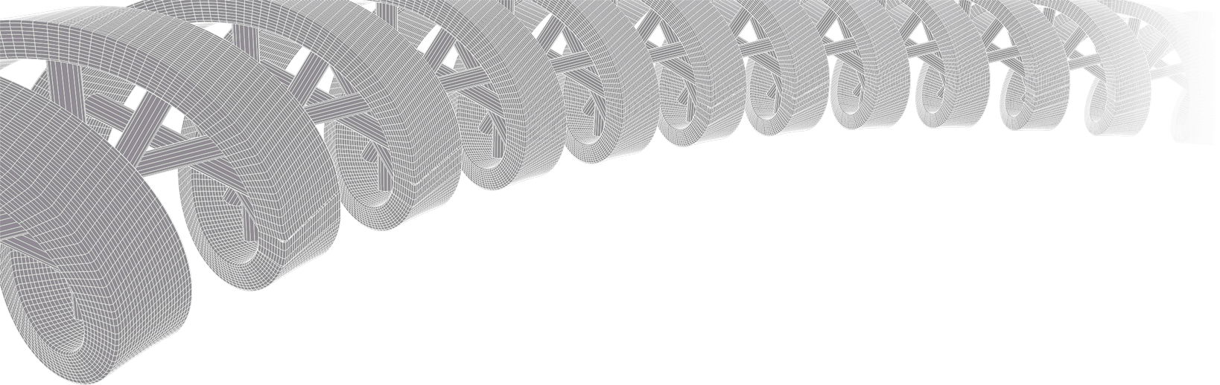
GenViz Module 0: Introductions
Malachi Griffith, Obi Griffith, Zachary Skidmore
Genomic Data Visualization and Interpretation
April 8-12, 2019
Freie Universität Berlin

Slide 2
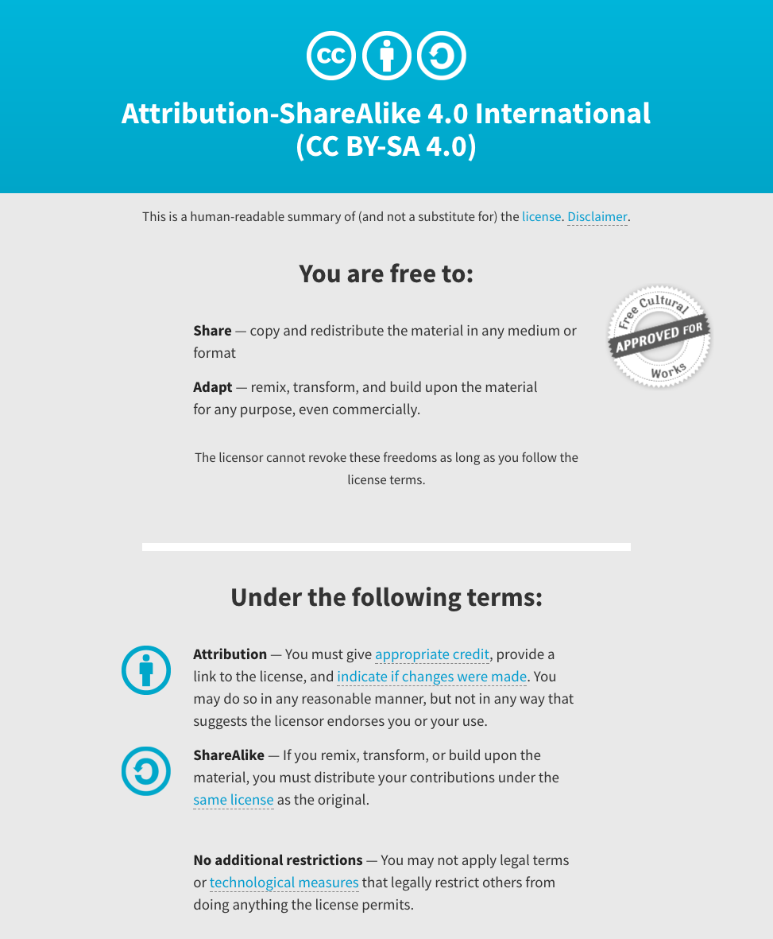
Notes:
Note there are two licenses if effect for this course.
All *content* (lectures, written materials, etc.) are made available under the Creative Commons Attribution-ShareAlike 4.0 International (CC BY-SA 4.0). (https://creativecommons.org/licenses/by-sa/4.0/).
All *code* (R scripts the website code itself) are made available under the MIT License (https://opensource.org/licenses/MIT).

Slide 3
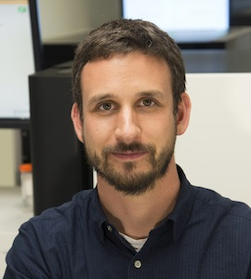
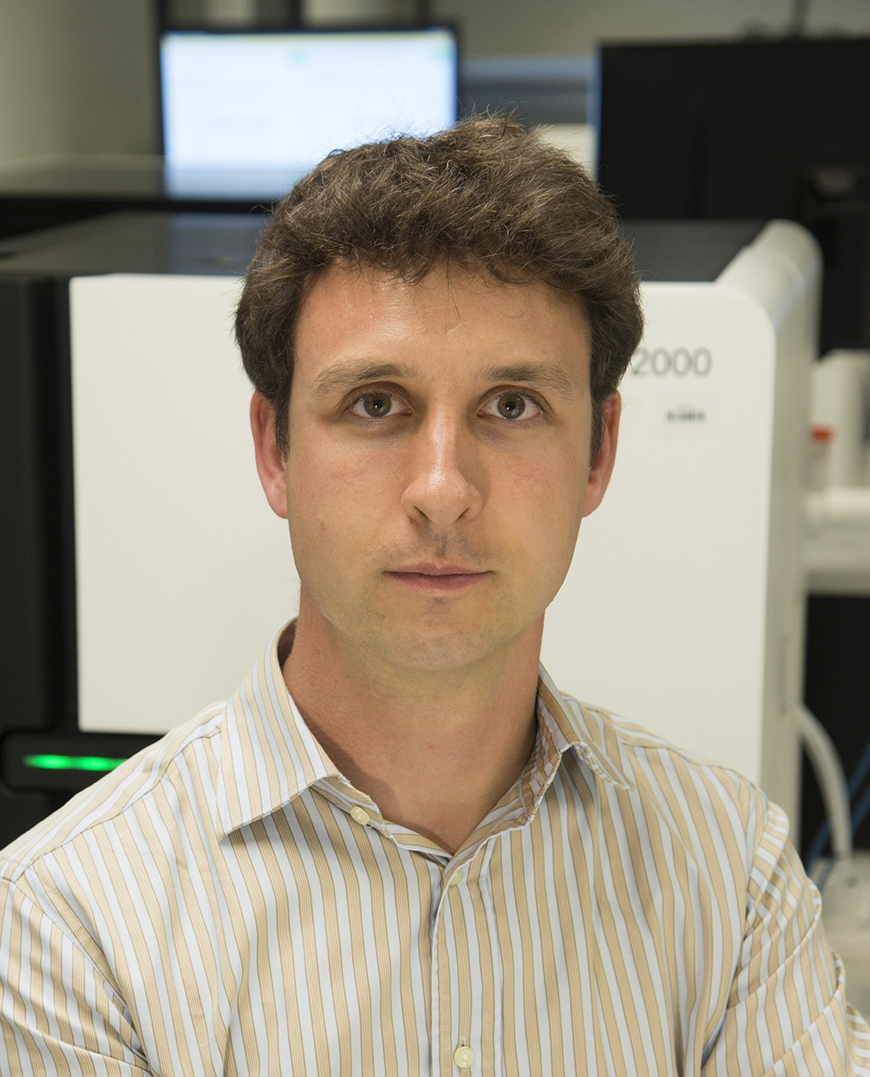
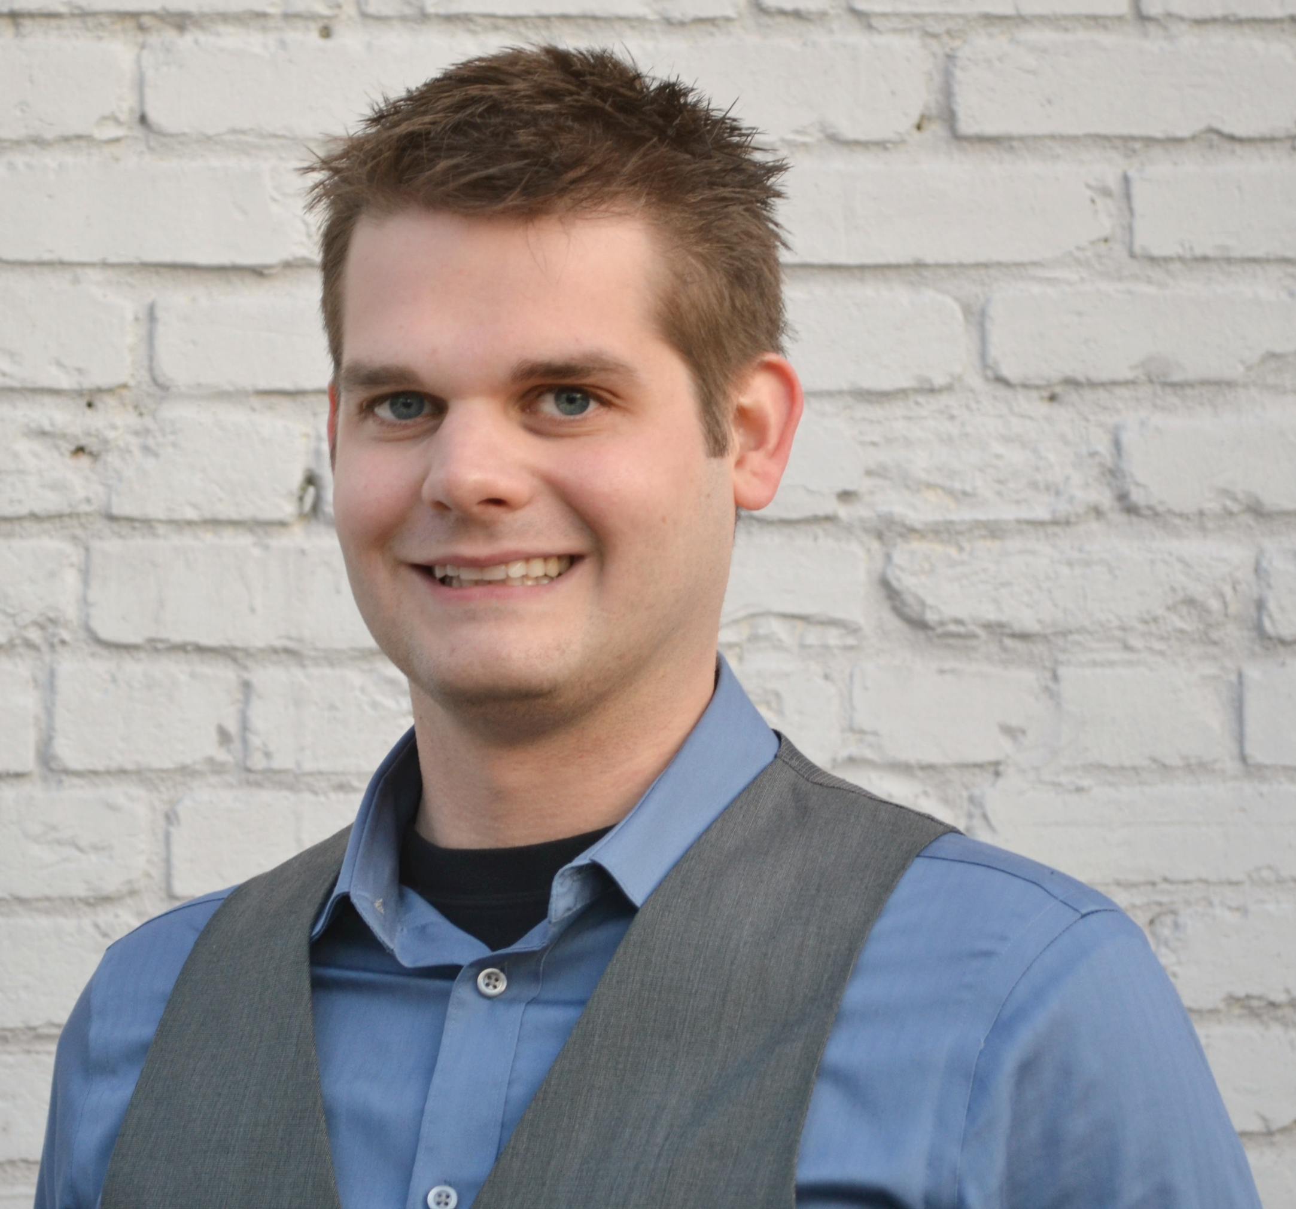
Introductions to course instructors
Malachi Griffith, PhD
Assistant Professor of Medicine Assistant Professor of Genetics
Assistant Director, MGI
Obi Griffith, PhD
Assistant Professor of Medicine Assistant Professor of Genetics
Assistant Director, MGI
Zachary Skidmore, MSc
Staff Scientist, MGI
GenVisR creator
McDonnell Genome Institute, Washington University School of Medicine
griffithlab.org

Slide 4
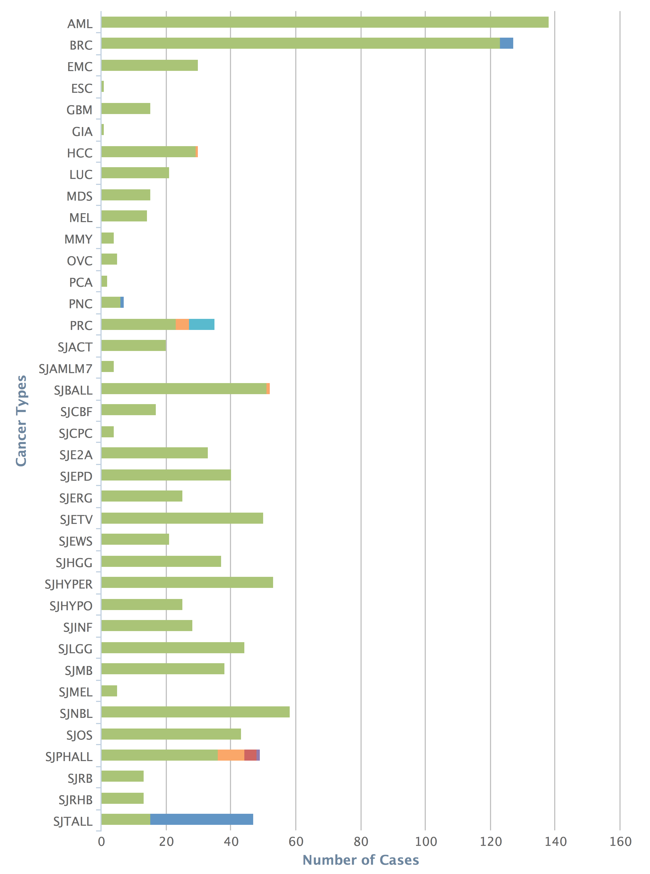
The McDonnell Genome Institute has pursued the field of genomics since inception: >1000 whole genomes, >5000 exomes, >1000 transcriptomes for dozens of tumor types
Human Genome Project
First to sequence and analyze a tumor whole genome sequence (Ley et al, 2008)
Major contributor to TCGA, PCGP, etc.
Most comprehensively sequenced single patient tumor ever published (Griffith et al, 2015)
Early proof-of-principle for cancer precision medicine (Griffith et al, 2016)
Analysis and tools for first personalized cancer vaccine design in humans (Carreno et al, 2015)
Many other widely used tools
Cancer types
Cases
MGI – 1000+ tumor whole genomes, many more exomes, X10 & NovaSeq will accelerate this!
Notes:
The McDonnell Genome Institute has been a leader in the field of cancer genome analysis from the first tumor genome to be sequenced (an AML case led by Dr. Tim Ley), to major contributions to large consortium efforts such as the Cancer Genome Atlas (TCGA) and Pediatric Cancer Genome Project (PCGP), to the most deeply sequenced individual tumor to date, to proof-of-principle cases for demonstrating the potential sequencing to guide cancer care, to the development of analysis methods and tools for some of the first trials of personalized cancer vaccines, and many other widely used tools. To date we have sequenced more than 1000 cancer whole genomes, more than 5000 whole exomes, and more than 1000 transcriptomes from dozens of tumor types. This represents a substantial fraction of the tumor genomes sequenced world wide.

Slide 5
Overview of lab’s research (griffithlab.org/research)
Cancer genome analysis
Breast cancer, Liver cancer, Lung cancer, Head and neck cancer, etc.
Variant Interpretation
Immunogenomics
Precision medicine for cancer
Genomics Tumor Board
Case Reports
Clinical Trials
Personalized Cancer Vaccines
Education projects
RNA-seq analysis and cloud computing (CBW, Toronto)
Advanced Sequencing Technologies and Applications (CSHL, New York)
Genomic Data Visualization/Interpretation (Physalia Courses, Berlin)
Precision Medicine Bioinformatics (PR Informatics, Glasgow)
High-Throughput Biology: From Sequence to Networks (CSHL / CBW, New York)
Workshop on Genomics (Evomics, Český Krumlov)
Tool development

Slide 6

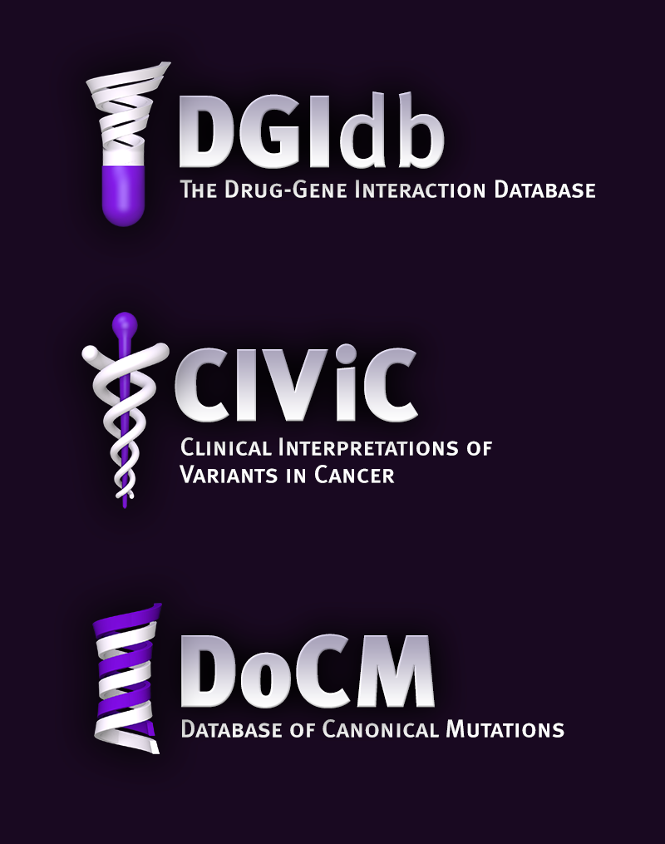

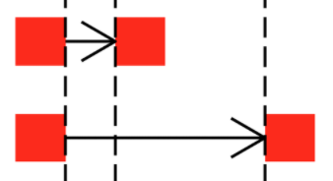
Where tools/resources do not exist we build them
www.dgidb.org
Search genes for known and potentially druggable interactions
https://github.com/griffithlab/pVAC-Seq
Personalize vaccine design
www.docm.info
Filter against highly curated set of mutations known to cause cancer
GenVisR
https://github.com/griffithlab/GenVisR
Create genomic visualizations
www.civicdb.org
Identify highly curated summaries of clinical interpretations for variants in cancer
regtools
https://github.com/griffithlab/regtools
Identify regulatory variants

Slide 7
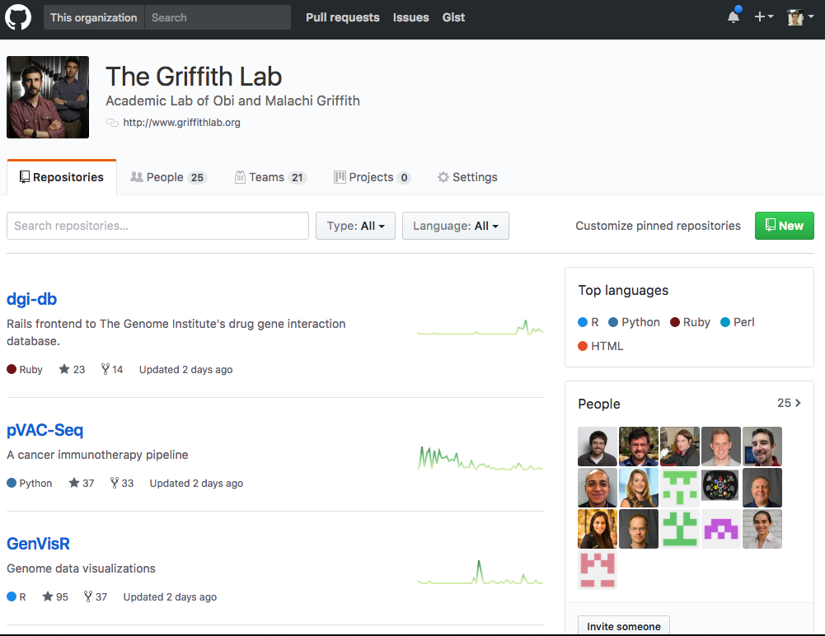
Encourage best practices for software development
All code deposited in Github
35+ repos for different software/projects
Virtually all public and open-source
Test-driven, code review, pull requests, etc
https://github.com/griffithlab
https://github.com/genome

Slide 8
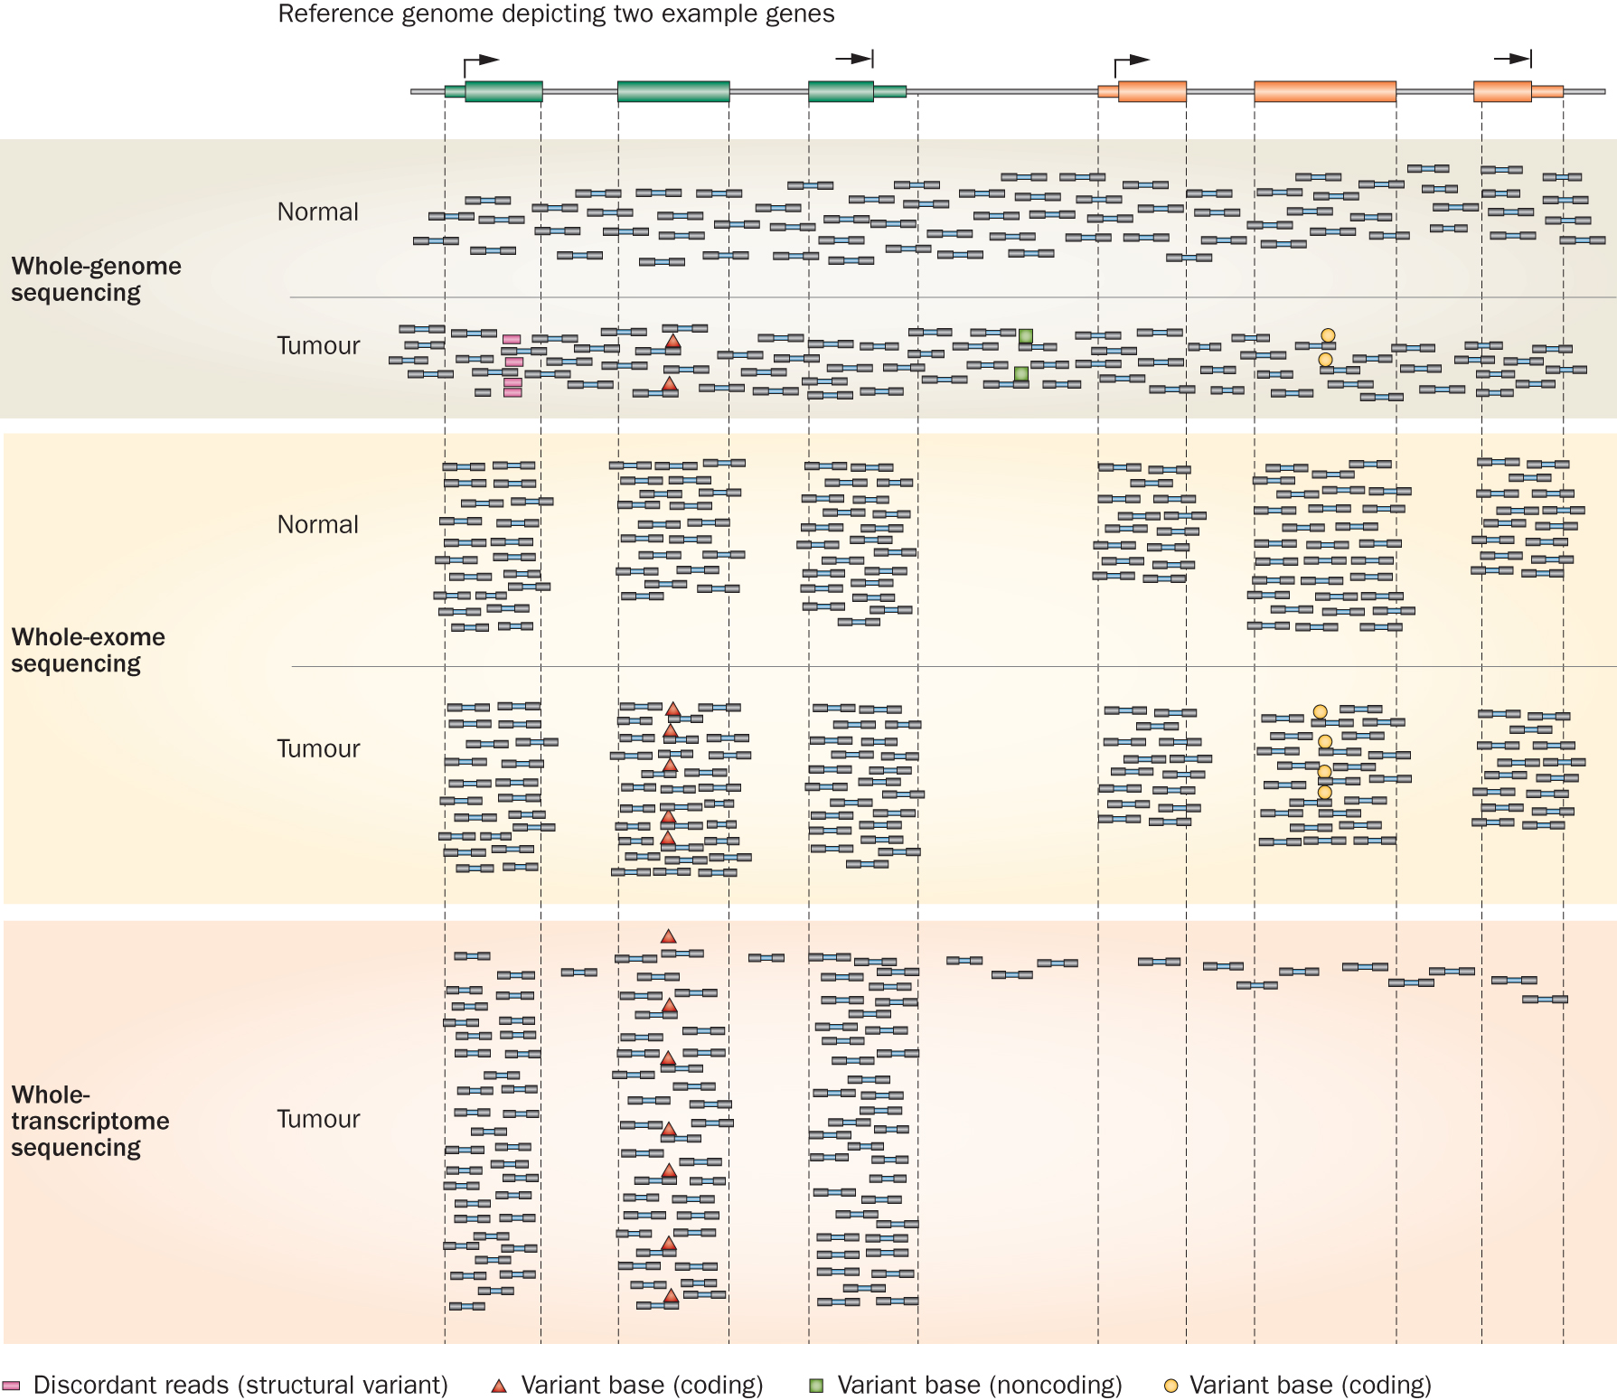
Whole genome, exome, transcriptome and other ‘omic’ sequencing allows us to detect and confirm many different variant types
‘WGS’
‘Exome’
‘RNA-seq’
Notes:
Each of these three data types, whole genome, exome and transcriptome, brings something to the table.
Whole genome gives you broad, even, and relatively unbiased coverage across the genome.
Exome gives you more focused coverage but much greater depth over the exons for a much lower cost than whole genome
RNA-seq gives you a snapshot of the transcriptome.

Slide 9
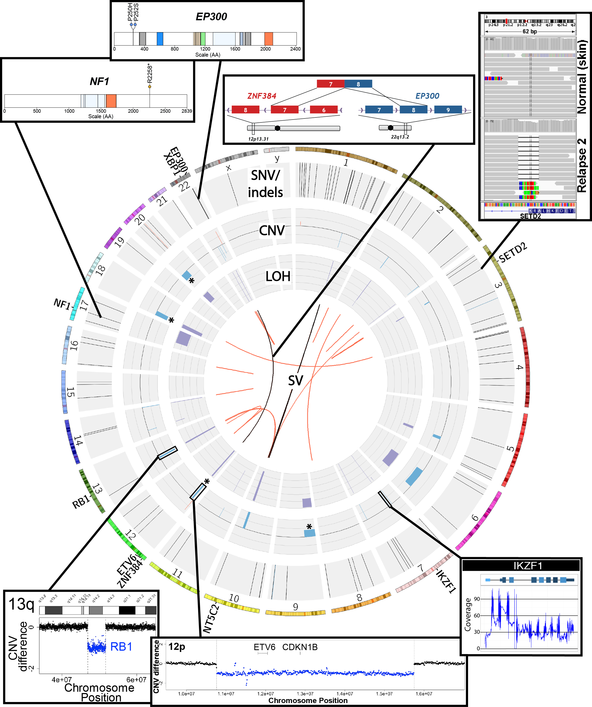
SNVs, Indels, CNVs, SVs, fusions, LOH, expression changes, methylation changes, and more
Notes:
Ultimately, an extremely comprehensive analysis was performed on this relapse tumor.
Many fascinating events were identified
The genome was characterized by a reasonable number of protein coding point mutations including those affecting EP300 and NF1.
While very little amplification was observed several rearrangements and both large and small deletions were apparent. These affected SETD2, XBP1, Ikaros, RB1, ETV6. SETD2 and NF1 were both hit twice.
An interesting EP300-ZNF384 fusion was identified.
At the time it was novel but has since been associated with other ALL patients.
While certainly interesting, none of these genomic events particularly suggested any clinical action.

Slide 10
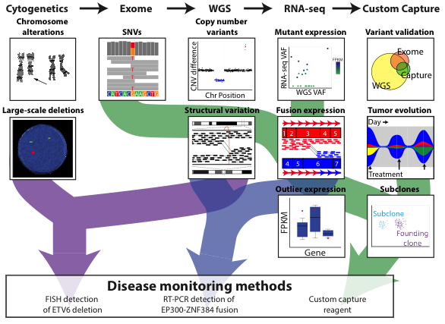
Comprehensive and integrative analysis methods are needed
Kilannin Krysiak
Notes:
As a proof-of-principle we took a very comprehensive approach. Though we balanced this with the need to complete data generation and a first version of the analysis quickly (41 days from receipt of sample to return of information).
By this time (2nd relapse), the patient had an extensive cytogenetics workup. To this we added exome, whole genome and RNA-seq.
Based on the WGS data we also created a custom NimbleGen capture reagent to cover all SNVs in the patient.
We used these data to identify SNVs and Indels, copy number variants, SVs, expressed variants, fusions, and outlier gene expression events.
The custom capture data was used largely to monitor disease burden in bone marrow samples obtained subsequent to the second relapse (and historical samples that were previously banked).

Slide 11
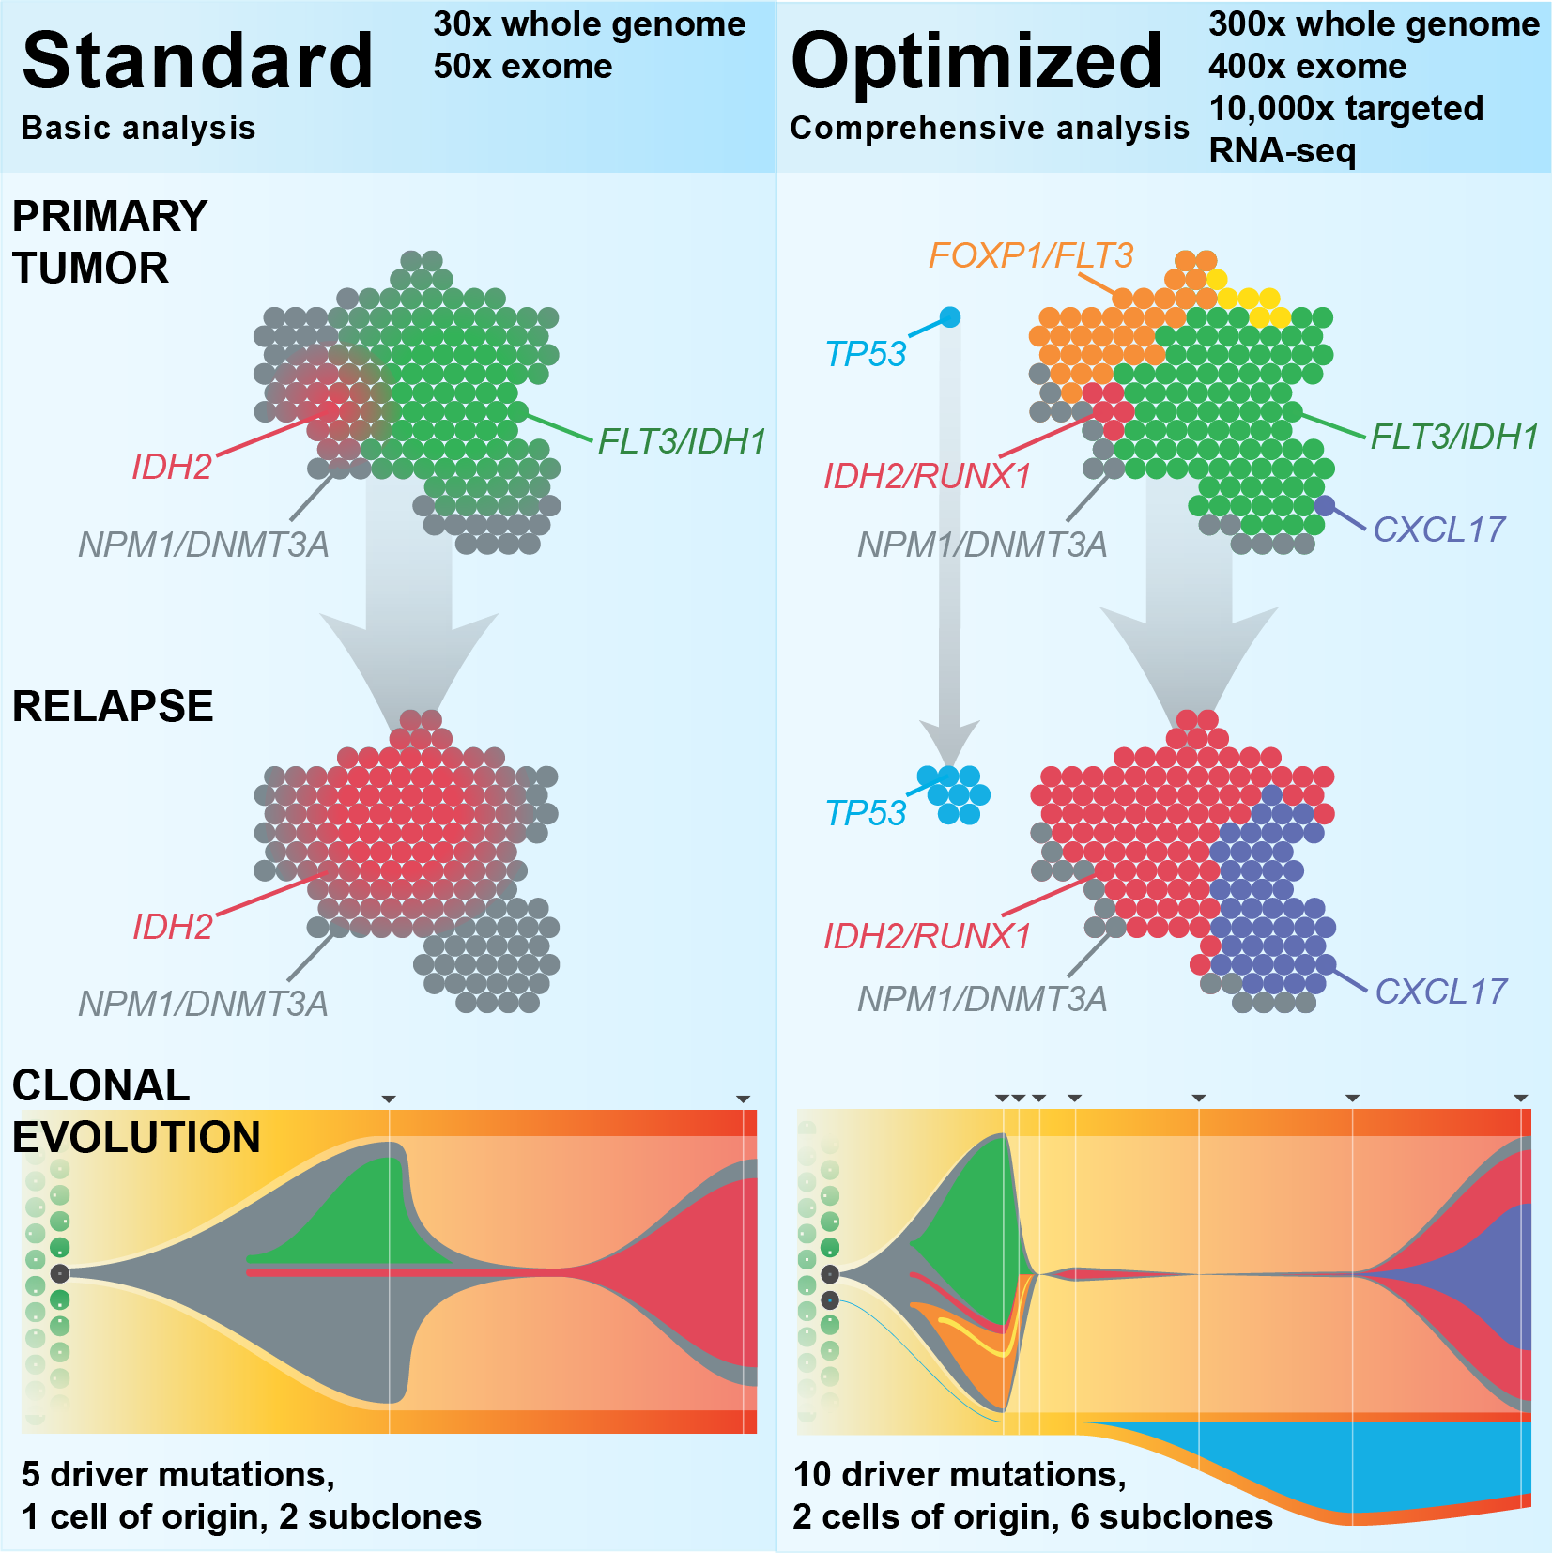
Each study often requires considerable customization
Griffith et al. 2015
Kilannin Krysiak

Slide 12
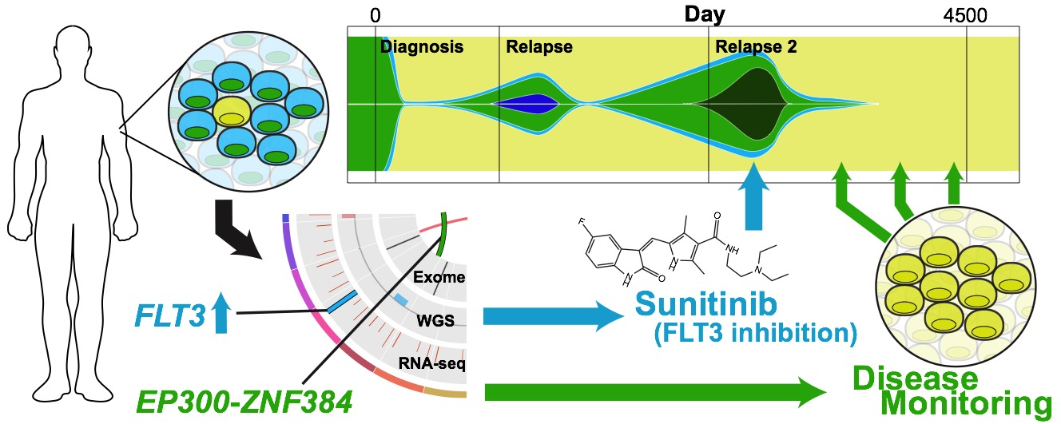
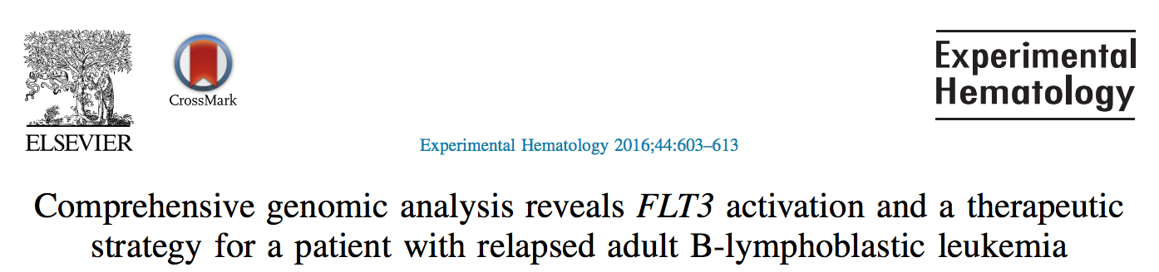
Personalized medicine requires personalized strategies
Griffith et al. 2016
Kilannin Krysiak

Slide 13
Strategies to bring genomics information to bear for as many cancer patients as possible
Precision medicine targeting of driver mutations
Leveraging passenger variants
Tracking minimal residual disease
Identifying neoepitopes
Predicting response to immunotherapy
Developing personalized vaccines

Slide 14
Precision medicine targeting of driver mutations
1980s: Development of Targeted Therapies
2000: Human Genome Sequencing Project
2001: FDA Approval for Imatinib in BCR-ABL1 CML
2014: FDA Approval for BRCA Testing
2017: FDA Approval of Pembro for MSI tumors
BRAF -> V600E -> Melanoma -> Predictive -> Vemurafenib
ERBB2 -> Amplification -> Breast -> Predictive -> Traztuzumab
EGFR -> L858R -> Lung -> Predictive -> Erlotinib
ALK -> Fusions -> Lung -> Predictive -> Crizotinib
EWSR1-FLI1 -> Fusions -> Ewing Sarcoma -> Diagnostic
DNAJB1-PRKACA -> Fusions -> flHCC -> Diagnostic
VHL -> Loss of function mutations -> Kidney -> Predisposing
… an increasingly long tail of rare but clinically relevant variants
Erica Barnell
Notes:
Notes on examples:
BRAF -> V600E -> Melanoma -> predictive?
EGFR -> L858R -> Lung -> predictive?
EGFR -> T790M -> Lung -> predictive?
ALK -> Fusions -> Lung -> predictive?
ERBB2 -> Amplification -> Breast -> predictive?
EWSR1-FLI1 -> Fusion -> Ewing Sarcome -> Diagnostic?
Secondary mutations in BCR-ABL1 that confer resistance?
PTEN Loss perhaps?
I would argue BRCA mutations should also be counted. Also, we are at the point where ER/PR/HER2/KI67 testing by RNA is cheaper and more accurate than IHC and really *should* be the clinical standard. Rolling out in less developed countries that don't have legacy dependency on IHC. NTRK fusions and inhibitors seem likely to have a wide impact
ERBB2 kinase domain mutations in breast cancer, while rare, are clearly clinically relevant
KIT mutations in GIST and some other tumors guide standard of care
There's about a dozen genes with mutations that inform FDA approved treatments and guidelines according to oncokb. Not as many as we would like but to say CML is the only example is really weird
I think the problem is that many of these are not being run routinely in the clinical setting outside of select academic hospital settings. But this is more a problem with slow/conservative clinical adoption and default resistance of insurance providers. It will take a few more years beating them over the heads with data. OHSU is planning to roll BRCA testing out to all patients in their system (hundreds of thousands or millions planned). Mary Claire King has been preaching this for years but think about how long we've known (or could impute) of the importance/value of this. Things just move show.
MSI -> nsclc -> nivolimab
Dnajb1-prkaca -> flHCC -> diagnostic
BTK -> C421 -> CLL -> predictive of resistance
Special subset of heme malignancies are defined by eosinophilia and pdgfra/b and one other gene.
Alk fusions are highly targetable.
Her2 targeting with trastuzumab changed the picture for these patients as far as I understand. Both of these are heavily represented in CIViC, and played a large role in MATCH basket trial. The data seems very much there in some of these trials, so it should only be a matter of time for it to be more accepted.
I noted the MSI (non gene entity) example, and think we should perhaps prioritize non gene entities a bit higher in our upcoming goals.
In general the variant clinical interpretations should help us address this topic more effectively. Maybe 5 years from now someone asking that same question could be directed to CIViC as part of the answer.
Prosigna (Produced by Nanostring) is a panel of ~50 RNA transcripts that predicts breast caner recurrence and is now included in international guidelines for breast cancer surveillance
Veracyte produces a bunch of genomic diagnostics including Afirma (Fine Needle Aspiration analysis to diagnose thyroid malignancy), Percepta (lung cancer diagnosis), and Envisia (IPF diagnosis)

Slide 15
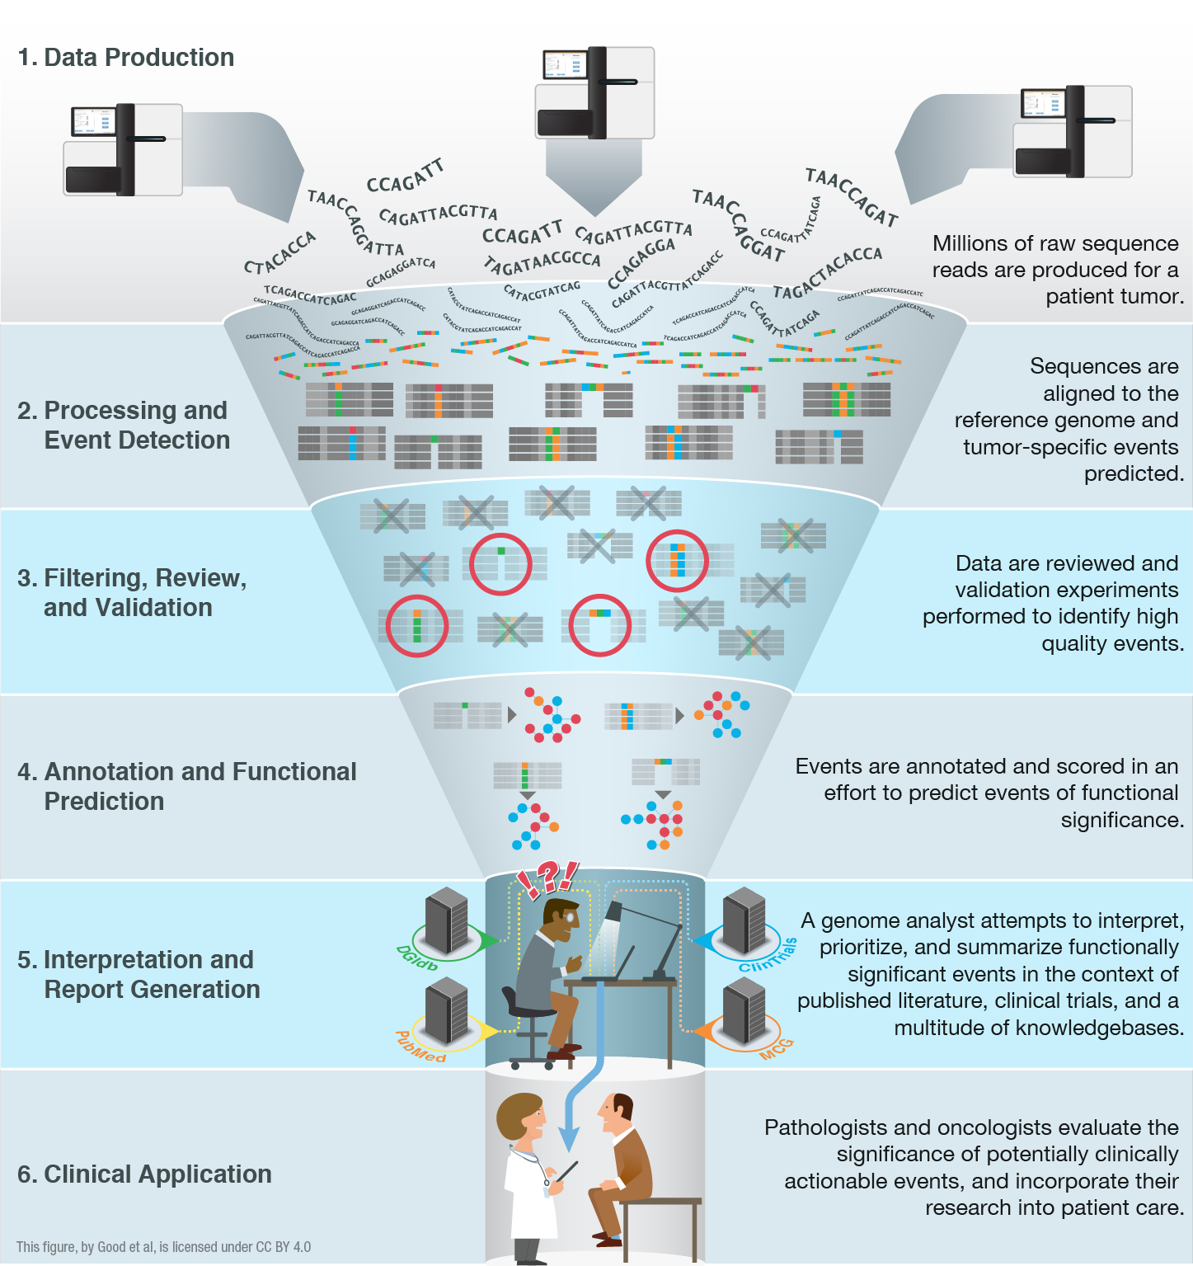
High-throughput sequencing has been largely automated allowing rapid identification of somatic and germline variants
Good BM, Ainscough BJ, McMichael JF, Su AI, Griffith OL. 2014. Genome Biology. 15(8):438.
Joshua McMichael
Notes:
We have an embarrassment of riches with all of the –omic events now being detected (though there is plenty of room for improvement!).
We are starting to have a handle on doing this routinely and quickly. We can generate the raw data, feed it into automated pipelines that process the data and predict genomic events. Filtering, review and validation thins these lists down to somewhat tractable counts of 10s to 100s of events. Where we are really stuck now is at the interpretation and report generation stage. This is a major bottleneck. The ‘genome analysts’ who have the skill sets to assemble final reports that a clinician might find useful are completely swamped.
One way to address this I already talked about. Education. We can train more of these genomics experts. But we also need to harness informatics strategies to make their job easier and address the bottleneck. With that in mind we are pursuing various data mining, crowd sourcing, natural language processing, etc.

Slide 16
Interpretation and visualization of genomic alterations remains the bottleneck for realizing precision medicine
Good BM, Ainscough BJ, McMichael JF, Su AI, Griffith OL. 2014. Genome Biology. 15(8):438.
Joshua McMichael
Notes:
We have an embarrassment of riches with all of the –omic events now being detected (though there is plenty of room for improvement!).
We are starting to have a handle on doing this routinely and quickly. We can generate the raw data, feed it into automated pipelines that process the data and predict genomic events. Filtering, review and validation thins these lists down to somewhat tractable counts of 10s to 100s of events. Where we are really stuck now is at the interpretation and report generation stage. This is a major bottleneck. The ‘genome analysts’ who have the skill sets to assemble final reports that a clinician might find useful are completely swamped.
One way to address this I already talked about. Education. We can train more of these genomics experts. But we also need to harness informatics strategies to make their job easier and address the bottleneck. With that in mind we are pursuing various data mining, crowd sourcing, natural language processing, etc.

Slide 17
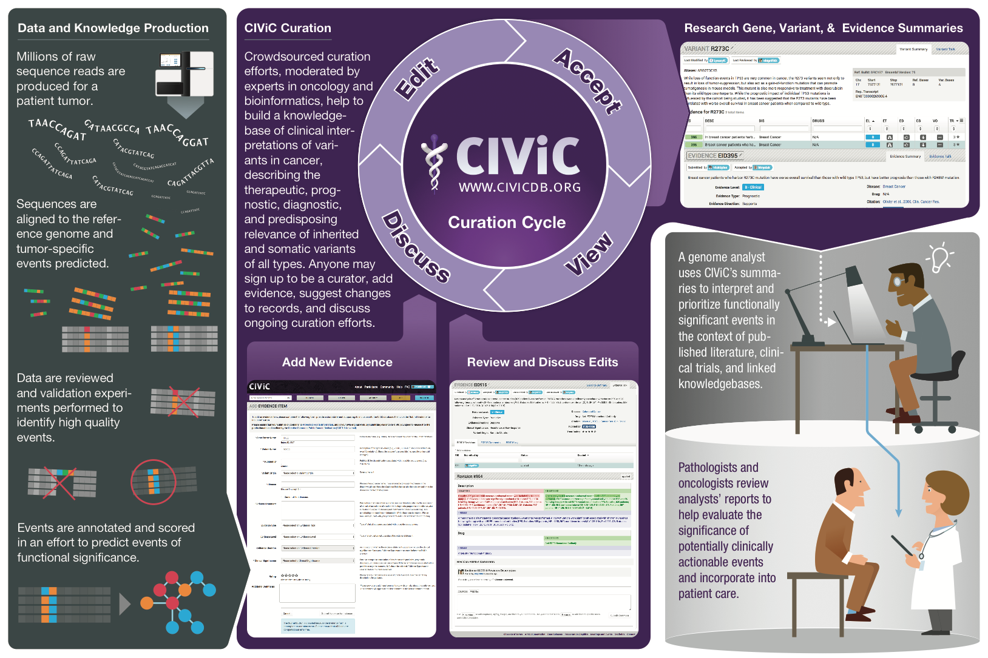
We created CIViC to address this need – an open knowledgebase and curation system for clinical interpretation of variants in cancer
www.civicdb.org
Joshua McMichael
Notes:
Goal: Create a resource that stores such interpretations, facilitates their creation, allows them to evolve rapidly (with provenance), and makes them publicly available for automated report generation

Slide 18
Strategies to bring genomics information to bear for as many cancer patients as possible
Precision medicine targeting of driver mutations
Leveraging passenger variants
Tracking minimal residual disease
Identifying neoepitopes
Predicting response to immunotherapy
Developing personalized vaccines

Slide 19
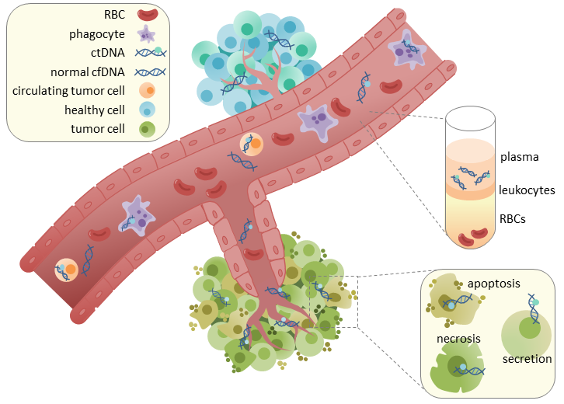
Circulating tumor DNA (ctDNA) could allow generalized tracking in any cancer type
Wikimedia Commons (CC BY-SA 4.0)
Notes:
https://en.wikipedia.org/wiki/Circulating_tumor_DNA#/media/File:CtDNA_in_circulation.png

Slide 20

ctDNA tracking in triple negative breast cancer
Blood for ctDNA
Blood for ctDNA
Blood for ctDNA
Blood for ctDNA every 6 months X 5 years
Research biopsy
Research biopsy
Research biopsy at surgery
DOCETAXEL AND CARBOPLATIN
ADJUVANT CHEMOTHERPY AT TREATING MDs DISCRETION
SURGERY
Stage 2/3TNBC
Tumor/ctDNA sequencing to identify mutations
Tumor/ctDNA sequencing to identify mutations
Tumor/ctDNA sequencing to identify mutations
Tumor/ctDNA sequencing to identify mutations
Clinical Trial: NCT02124902 (Contact PI: Foluso Ademuyiwa)
Notes:
- Of course doing this in blood tumors is one thing, doing it in solid tumors adds a level of difficulty.

Slide 21
Strategies to bring genomics information to bear for as many cancer patients as possible
Precision medicine targeting of driver mutations
Leveraging passenger variants
Tracking minimal residual disease
Identifying neoepitopes
Predicting response to immunotherapy
Developing personalized vaccines

Slide 22
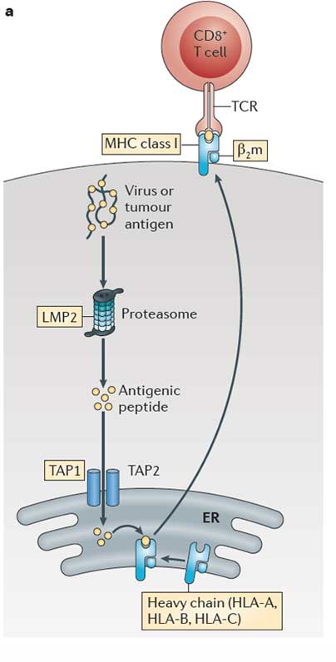
Invoking an adaptive immune response against the tumor (focus on CD8+ T cells)
4. T cell receptor that uniquely matches the tumor peptide
3. Neoantigen peptide presented by MHC
1. Tumor produces a unique peptide corresponding to a somatic mutation
2. Processing and presentation of the tumor specific peptide
Notes:
HLA typing essential to epitope prediction
In immunoepitope prediction, we identify novel, cancer-specific peptides that bind to MHC class I molecule of a specific HLA type
NOTE: In the cancer disease state the interaction of PD-L1 (ligand) on the tumor cell surface with PD-1 (receptor) on a T-cell reduces T-cell function signals to prevent the immune system from attacking the tumor cells. Checkpoint blockade therapies block this interaction by targeting either side of the interaction.
NOTE: CTLA4 is up-regulated in activated T-cells where (when bound to CD80 or CD86 on the surface of antigen presenting cells) it acts as an off switch for the immune system.

Slide 23
Neoepitope characterization workflow
HLA typing
Jasreet Hundal & Katie Campbell
Shirley X. Liu, Elaine R. Mardis. Applications of Immunogenomics to Cancer. Cell Press. 2017.
Notes:
MHC multimers are oligomeric forms of MHC molecules, designed to identify and isolate T-cells with high affinity to specific antigens amid a large group of unrelated T-cells.

Slide 24
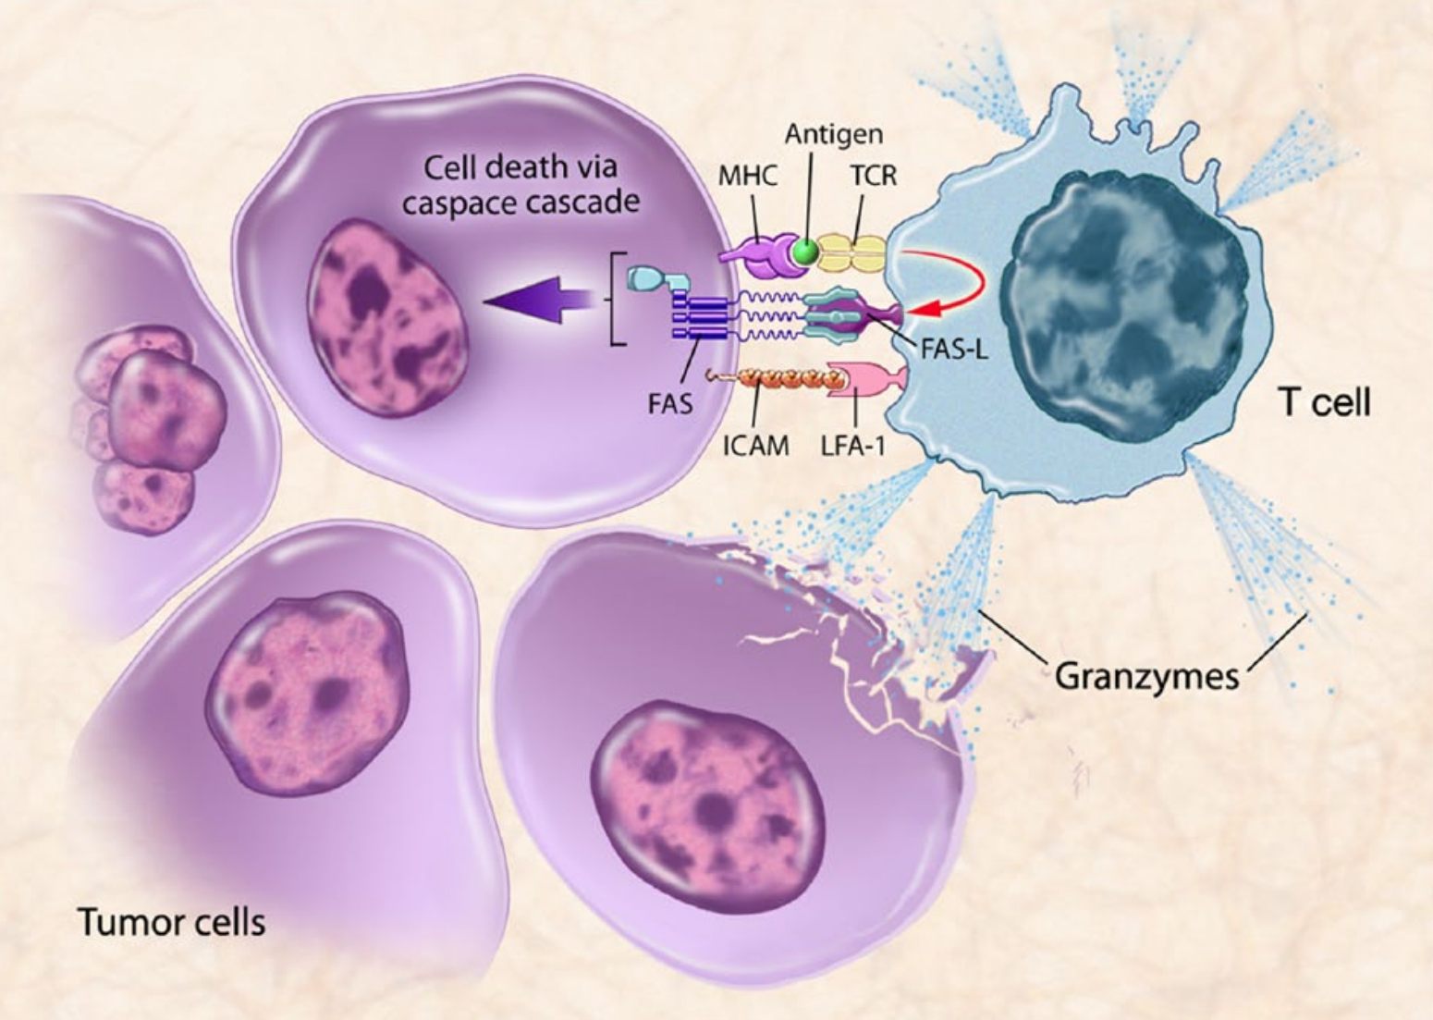
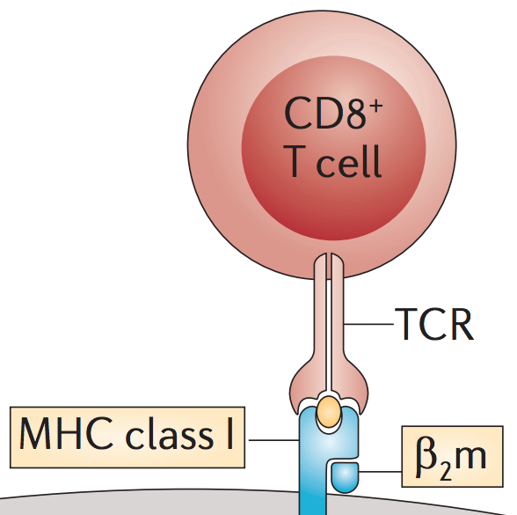
T cell mediated cell death
Singh and Gulley, 2014
Notes:
“T-cell mediated killing of tumor cells. Therapeutic cancer vaccines are designed to stimulate immune cells to target specific tumor-associated antigens (TAAs) overexpressed on cancer cells. Antigen-presenting cells (APCs) present antigens to the immune system via major histocompatibility complex molecules, which bind to T-cell receptors (TCRs). Activated T-cells travel to the tumor, recognized by the TAAs presented in the context of the major histocompatibility complex (MHC), leading to T cell-mediated killing of tumor cells by immunogenic cell death. When T cells specific for that MHC-antigen complex become activated, they upregulate Fas ligand, bind to Fas on the tumor cell, and initiate a downstream caspase cascade, leading to tumor cell apoptosis. Activated T cells can also release granzymes that can kill the target cell and surrounding tumor cells. Thus, expression of MHC and TAAs, as well as Fas, on the tumor cell enables T-cell recognition and killing of tumor cells. FAS-L, Fas-ligand; ICAM, intracellular adhesion molecule; LFA-1, lymphocyte function-associated antigen 1.”

Slide 25
Personalized cancer vaccine trials
Kidney Cancer (n = 15 patients)
PolyImmune {Durvalumab (MEDI4736) and Tremelimumab} & Vaccine Orchestrated Treatment for Patients With Advanced/Metastatic Renal Cell Carcinoma (NCT03598816). Collaboration with MedImmune.
Lung Cancer (n = 15 patients)
A Personal Cancer Vaccine (NEO-PV-01) With Pembrolizumab and Chemotherapy for Patients With Lung Cancer (NCT03380871). Collaboration with Neon Therapeutics and Merck.
Glioblastoma (n = 30 patients)
Neoantigen-based Personalized Vaccine Combined With Immune Checkpoint Blockade Therapy in Patients With Newly Diagnosed, Unmethylated Glioblastoma (NCT03422094)
Breast Cancer (n = 54 patients)
Neoantigen DNA Vaccine Alone vs. Neoantigen DNA Vaccine Plus Durvalumab in Triple Negative Breast Cancer Patients Following Standard of Care Therapy (NCT03199040). Collaboration with MedImmune.
Safety and Immunogenicity of a Personalized Polyepitope DNA Vaccine Strategy in Breast Cancer Patients With Persistent Triple-Negative Disease Following Neoadjuvant Chemotherapy (NCT02348320)
Follicular Lymphoma (n = 20 patients)
Personalized Tumor Vaccine Strategy and PD-1 Blockade in Patients With Follicular Lymphoma (NCT03121677). Collaboration with Bristol-Myers Squibb.
Prostate Cancer (n = 20 patients)
Neoantigen DNA Vaccine in Combination With Nivolumab/Ipilimumab and PROSTVAC in Metastatic Hormone-Sensitive Prostate Cancer (NCT03532217). Collaboration with Bristol-Myers Squibb.
Pancreatic Cancer (n = 15 patients)
Neoantigen DNA Vaccine in Pancreatic Cancer Patients Following Surgical Resection and Adjuvant Chemotherapy (NCT03122106).
Melanoma (n = 12 patients)
Dendritic Cell Vaccination in Patients With Advanced Melanoma (NCT03092453). Collaboration with UPenn/Parker ICI.

Slide 26
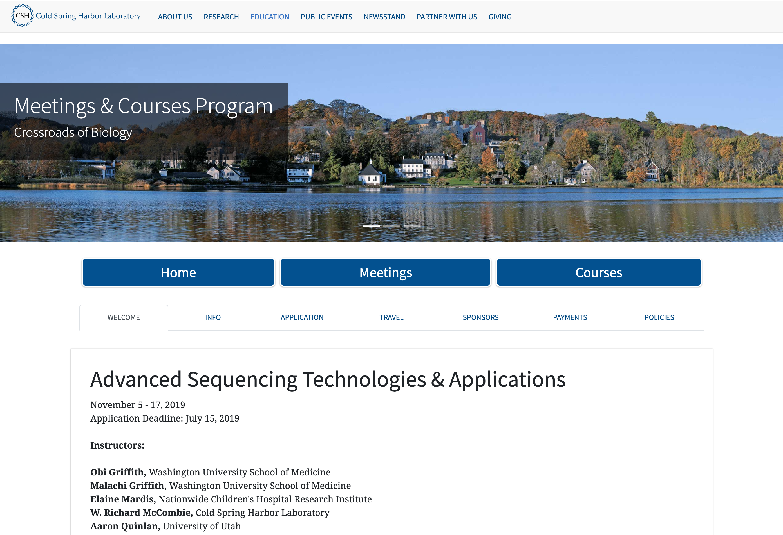
Advanced Sequencing Technologies and Applications at CSHL
https://meetings.cshl.edu/courses.aspx?course=C-SEQTEC&year=19

Slide 27
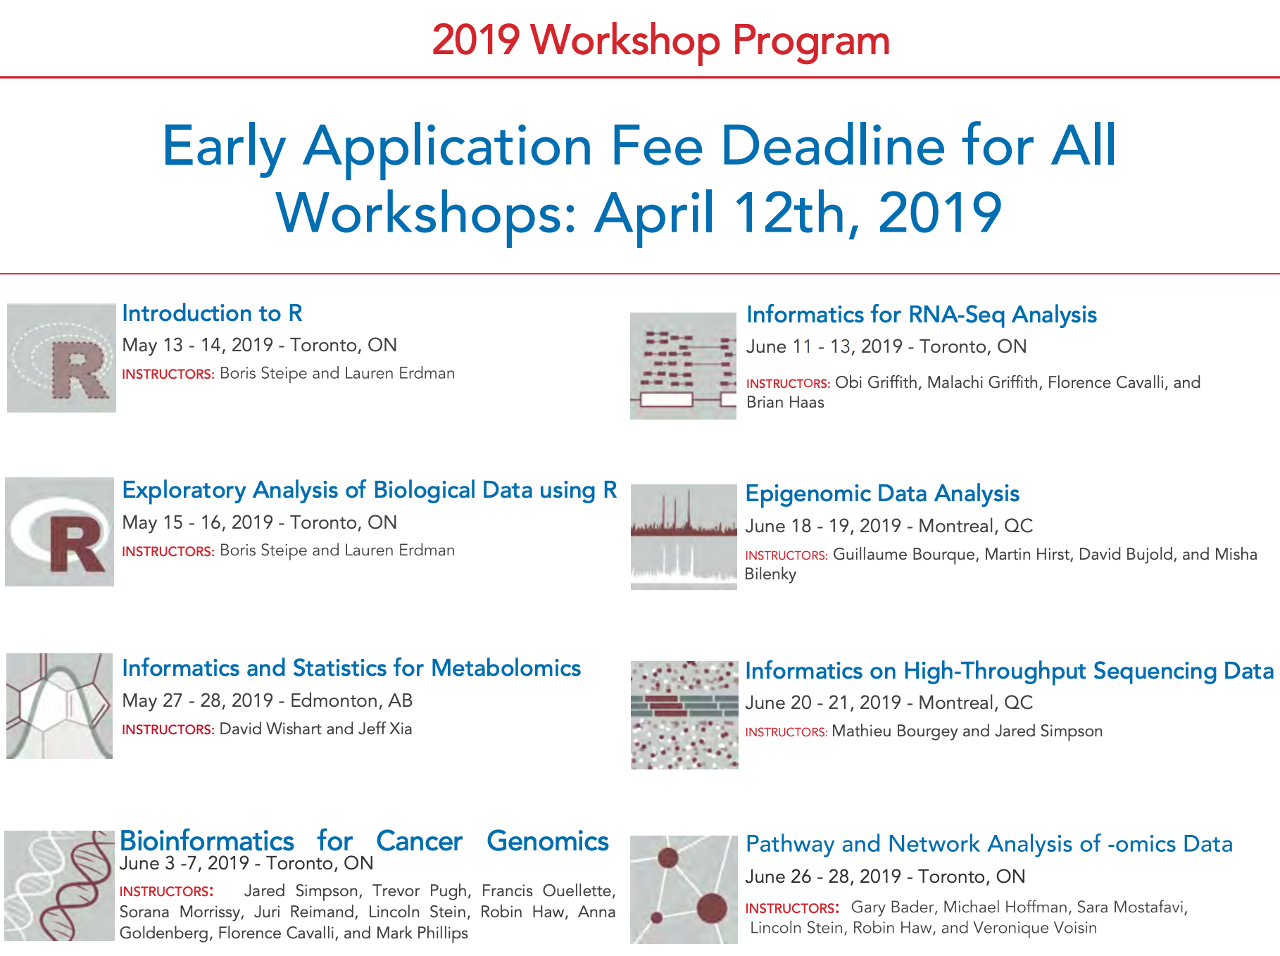
Canadian Bioinformatics Workshop Series
https://bioinformatics.ca/

Slide 28



Online courses available (griffithlab.org/teaching)
rnabio.org
genviz.org
pmbio.org

Slide 29
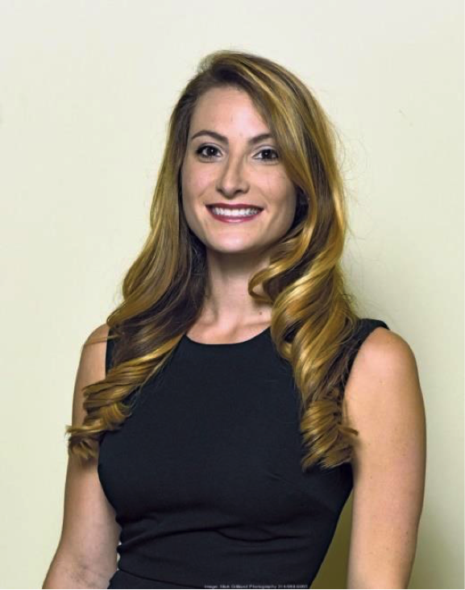
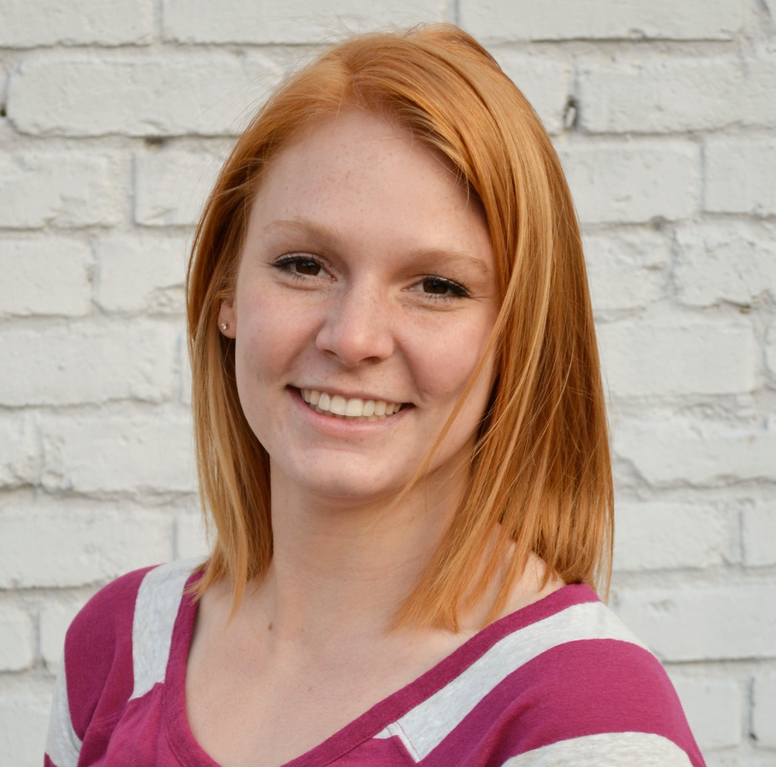
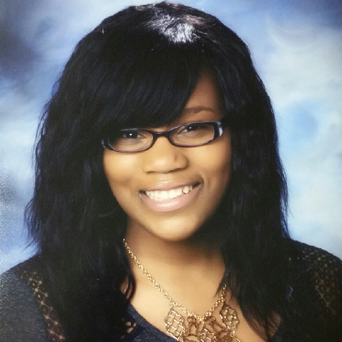
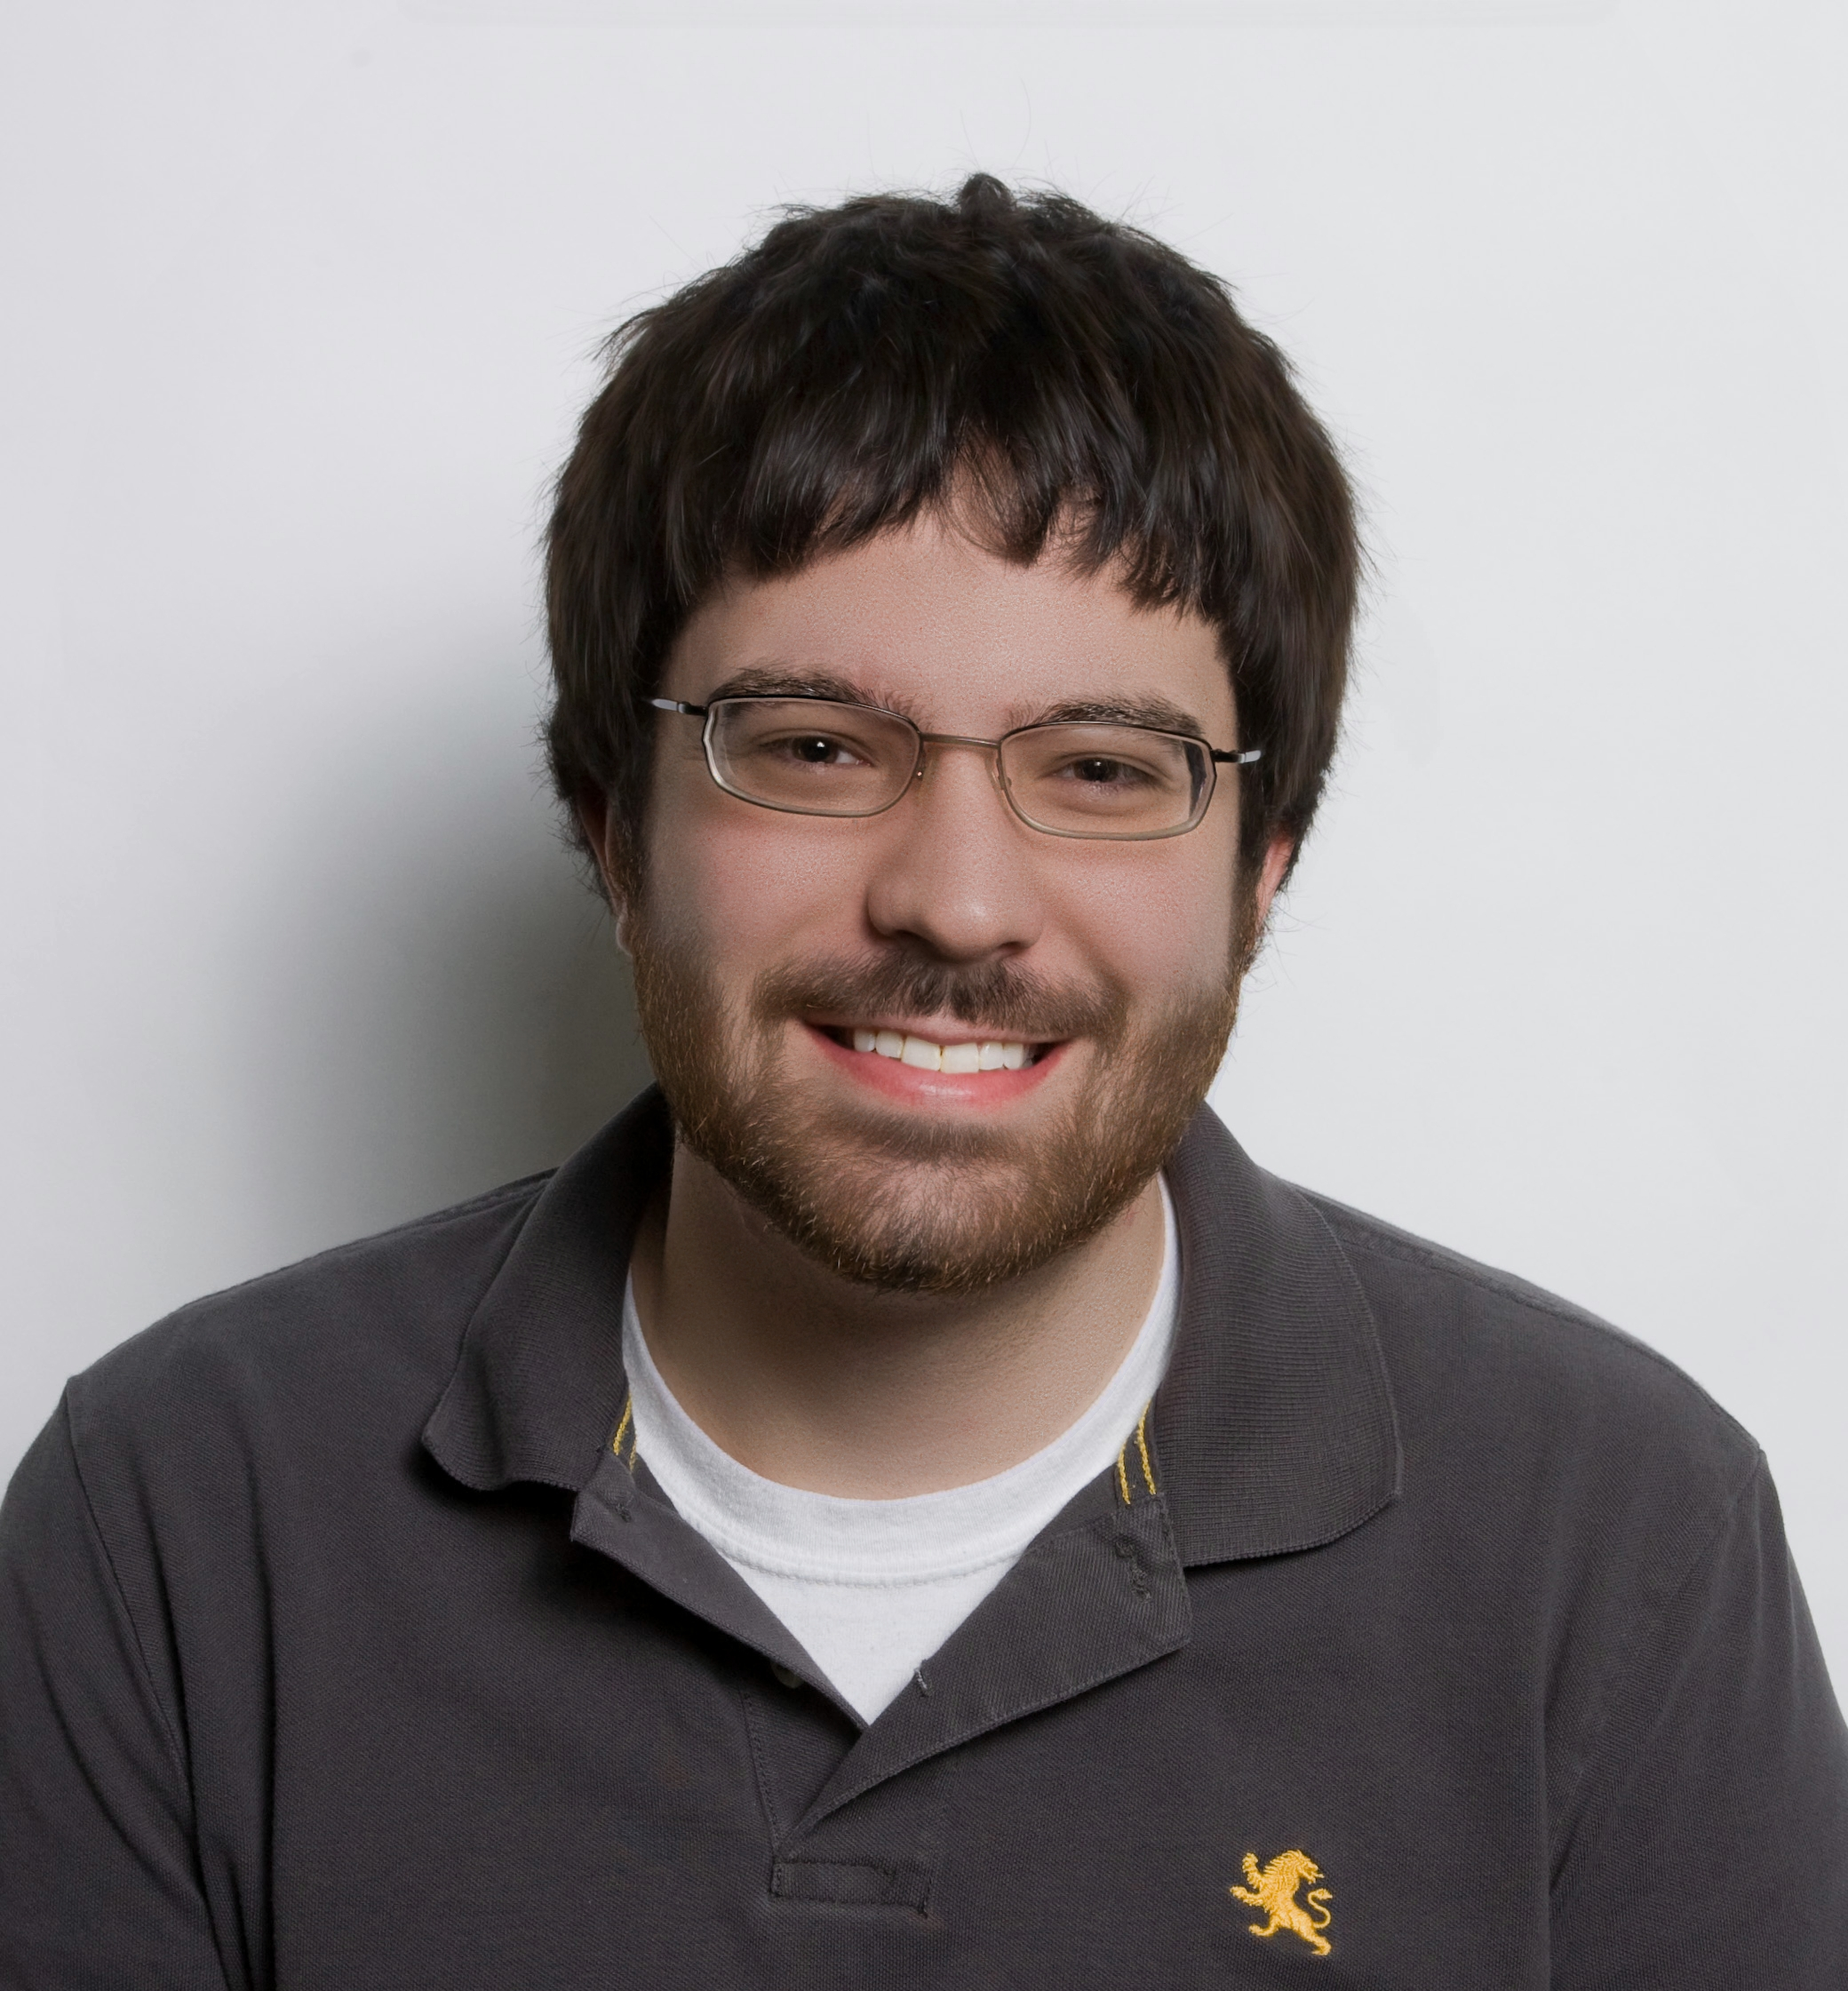
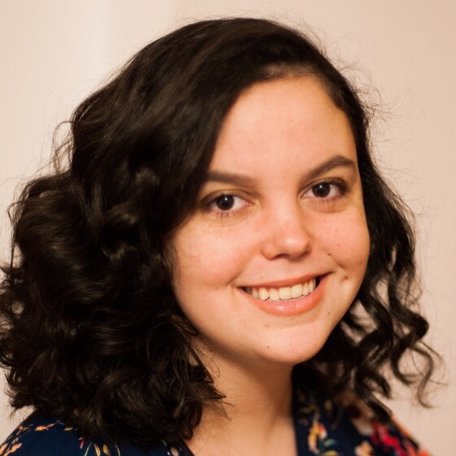
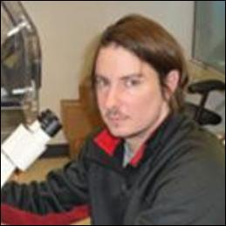


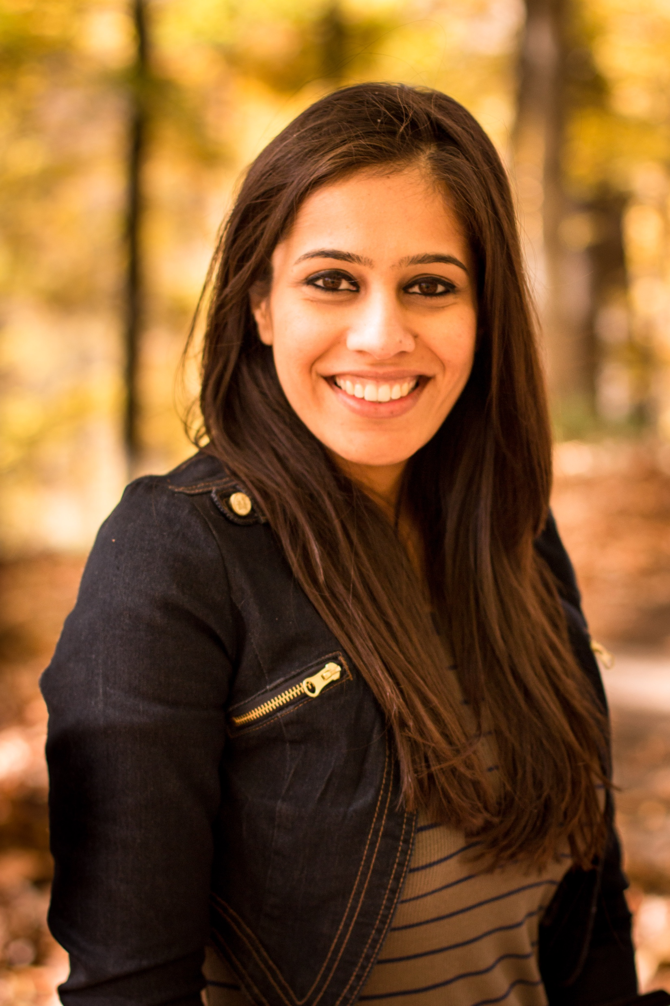
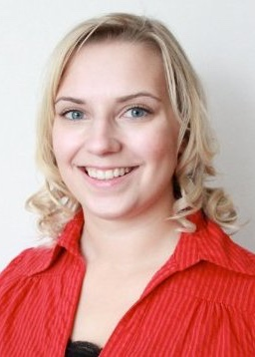
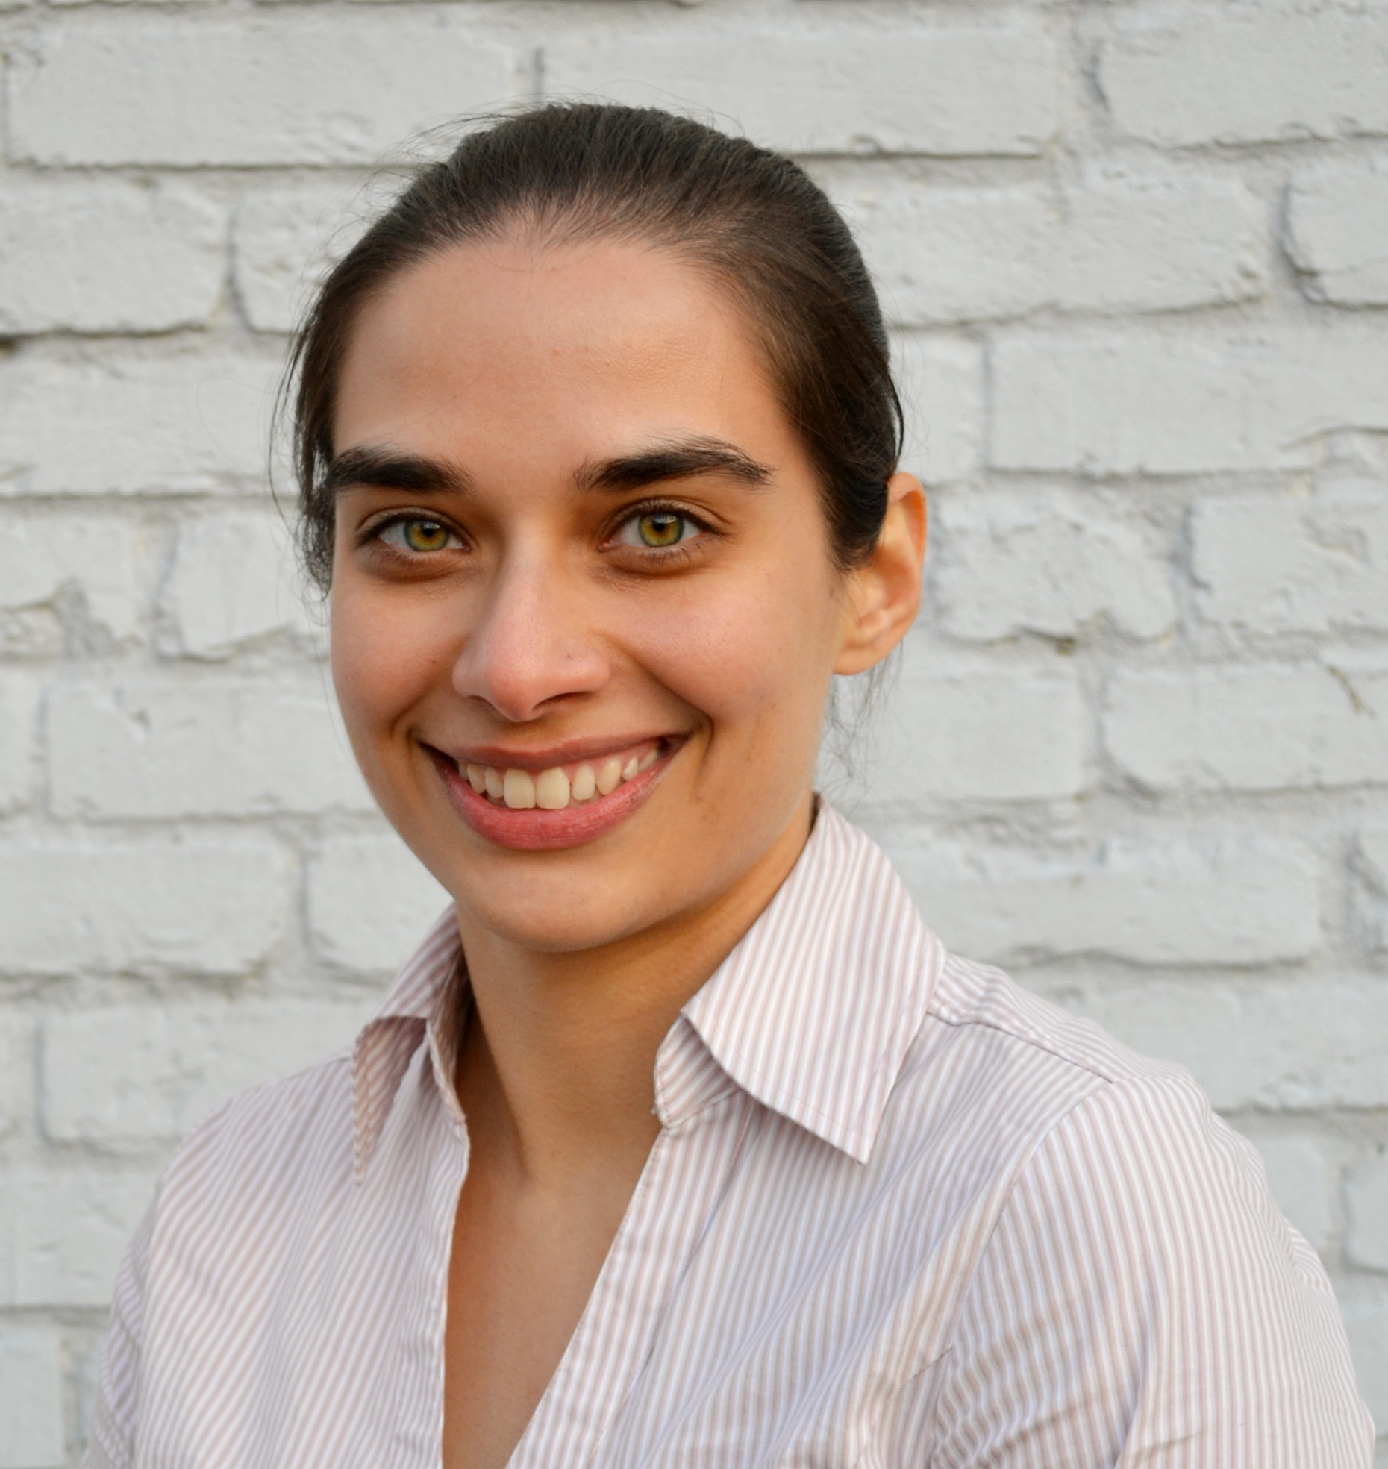
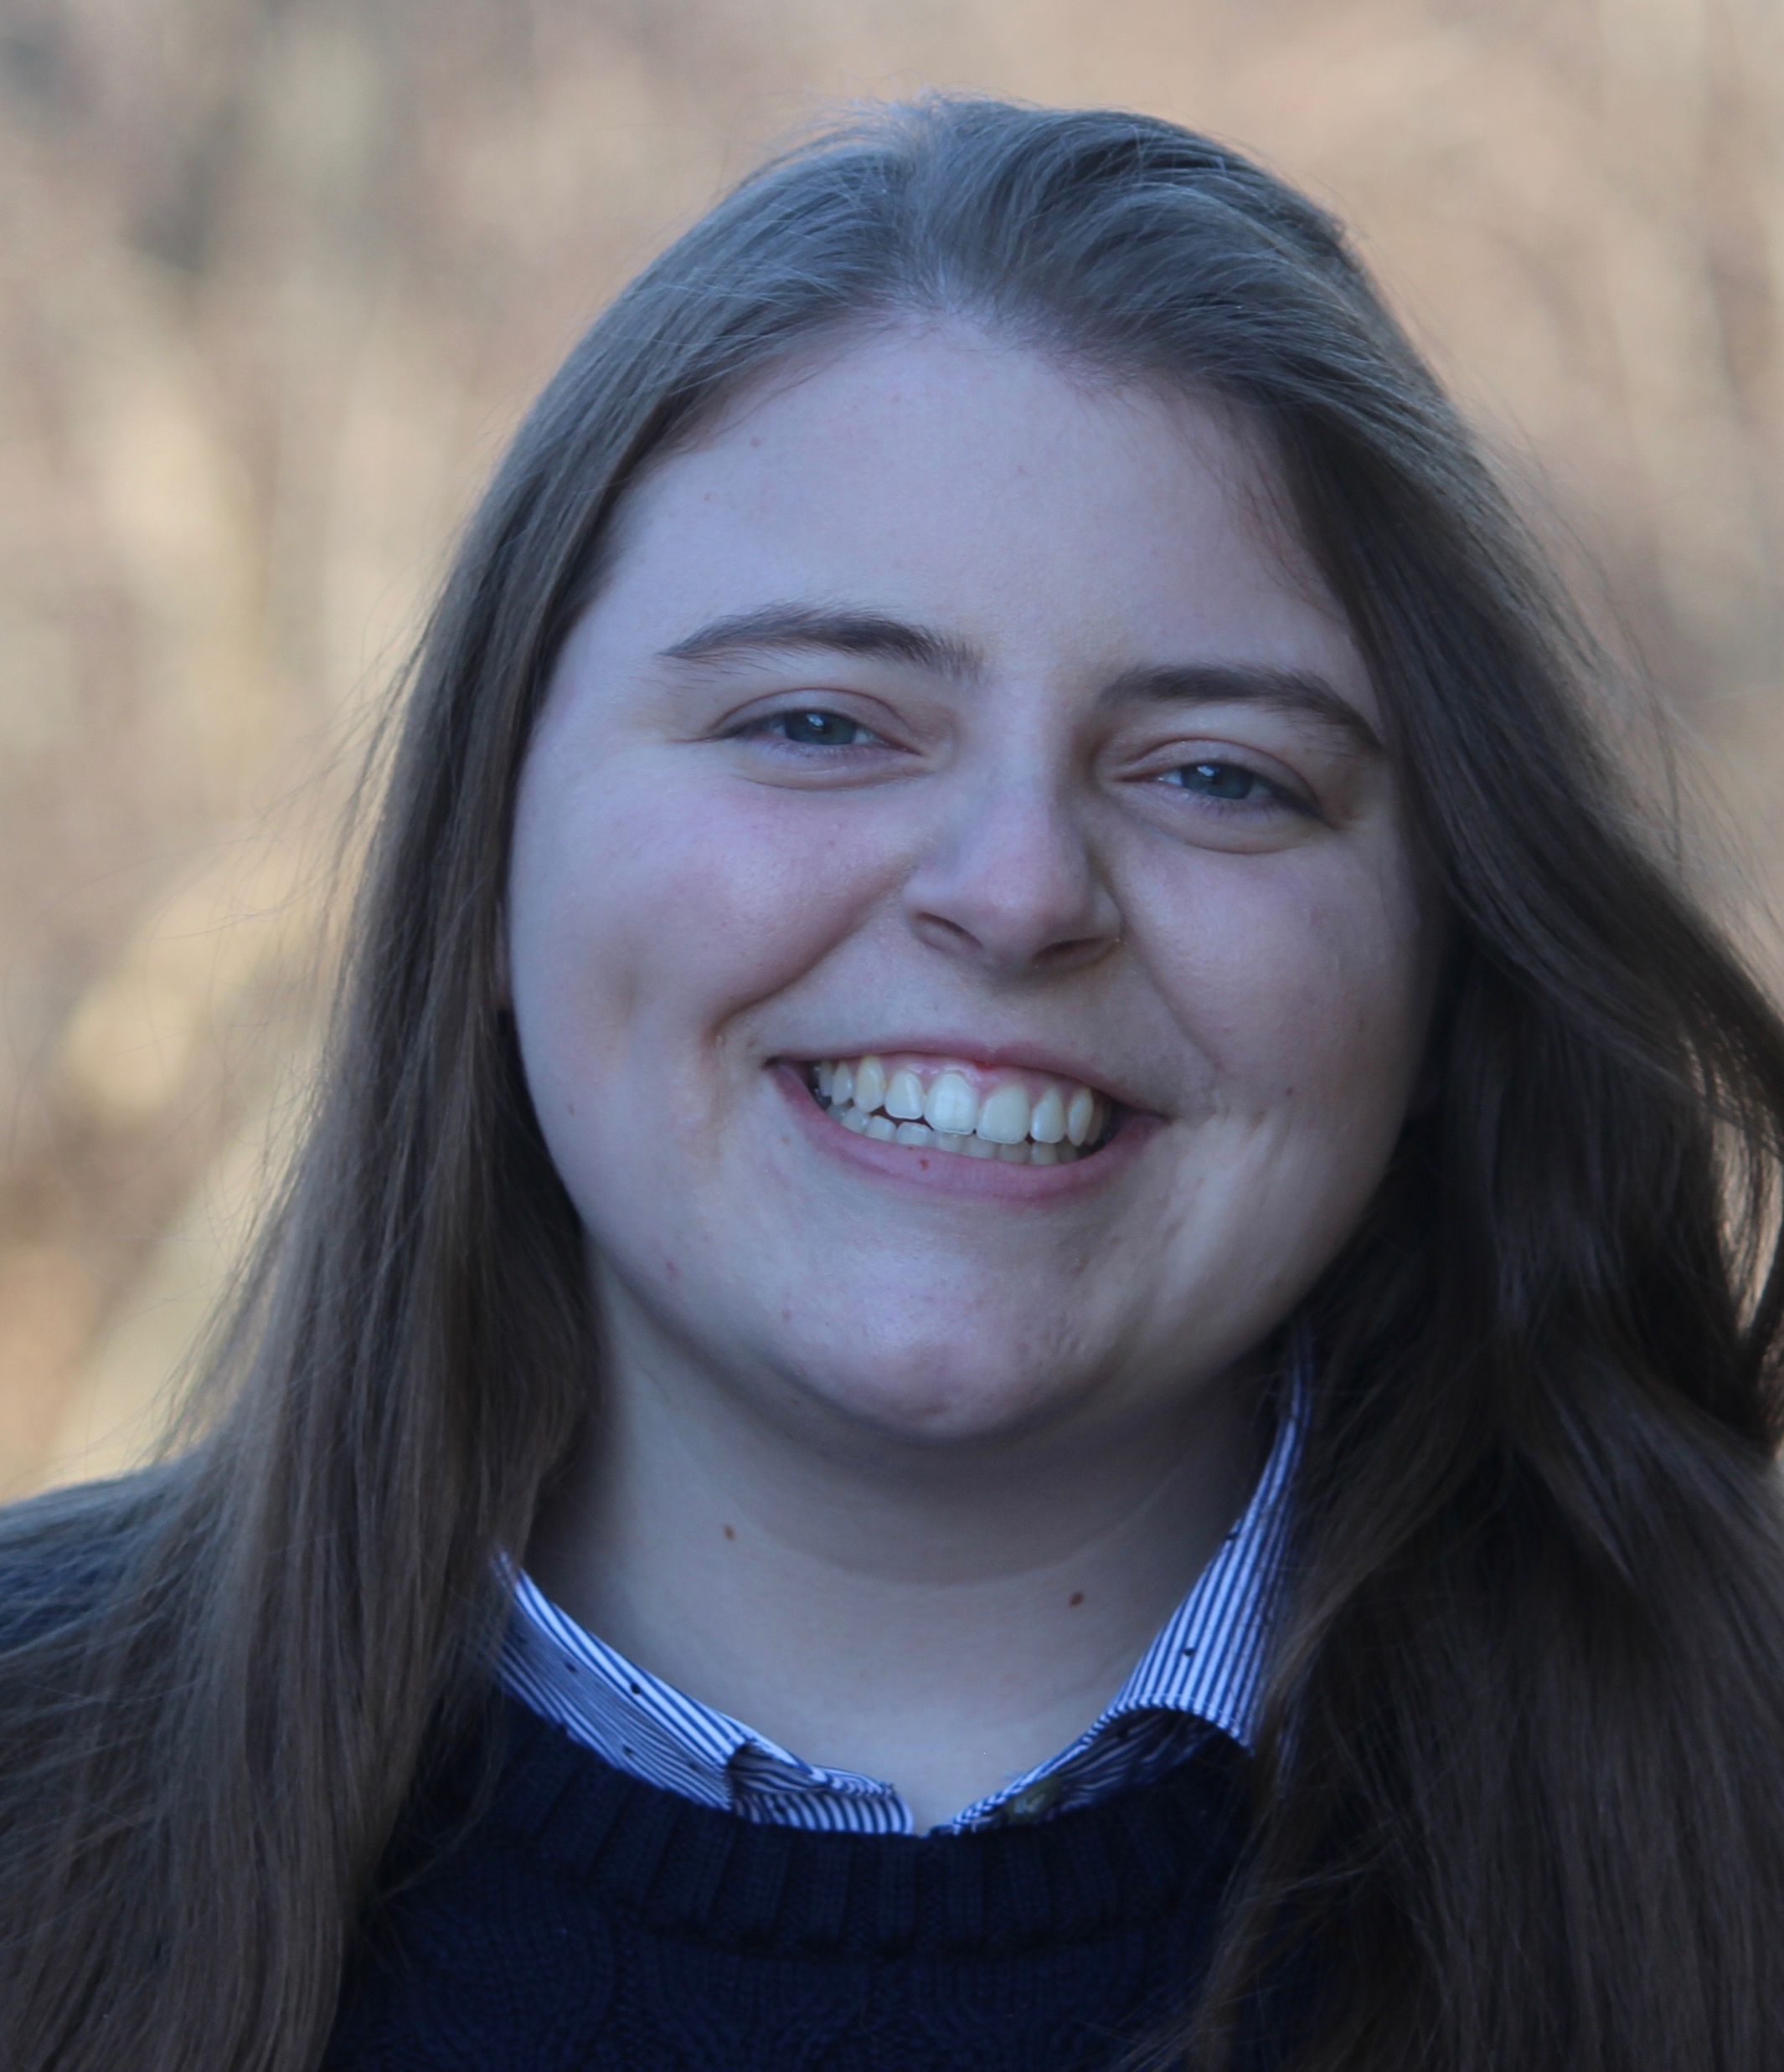
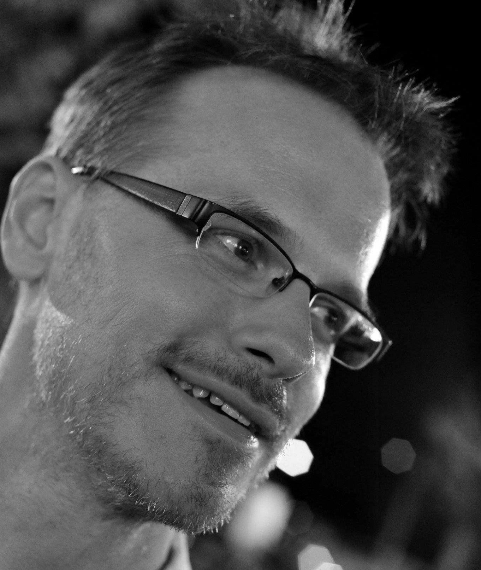
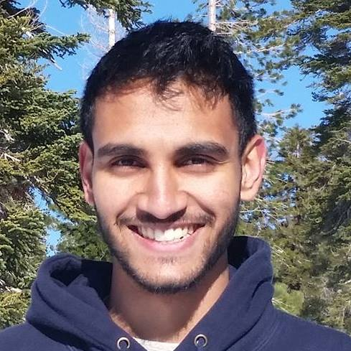
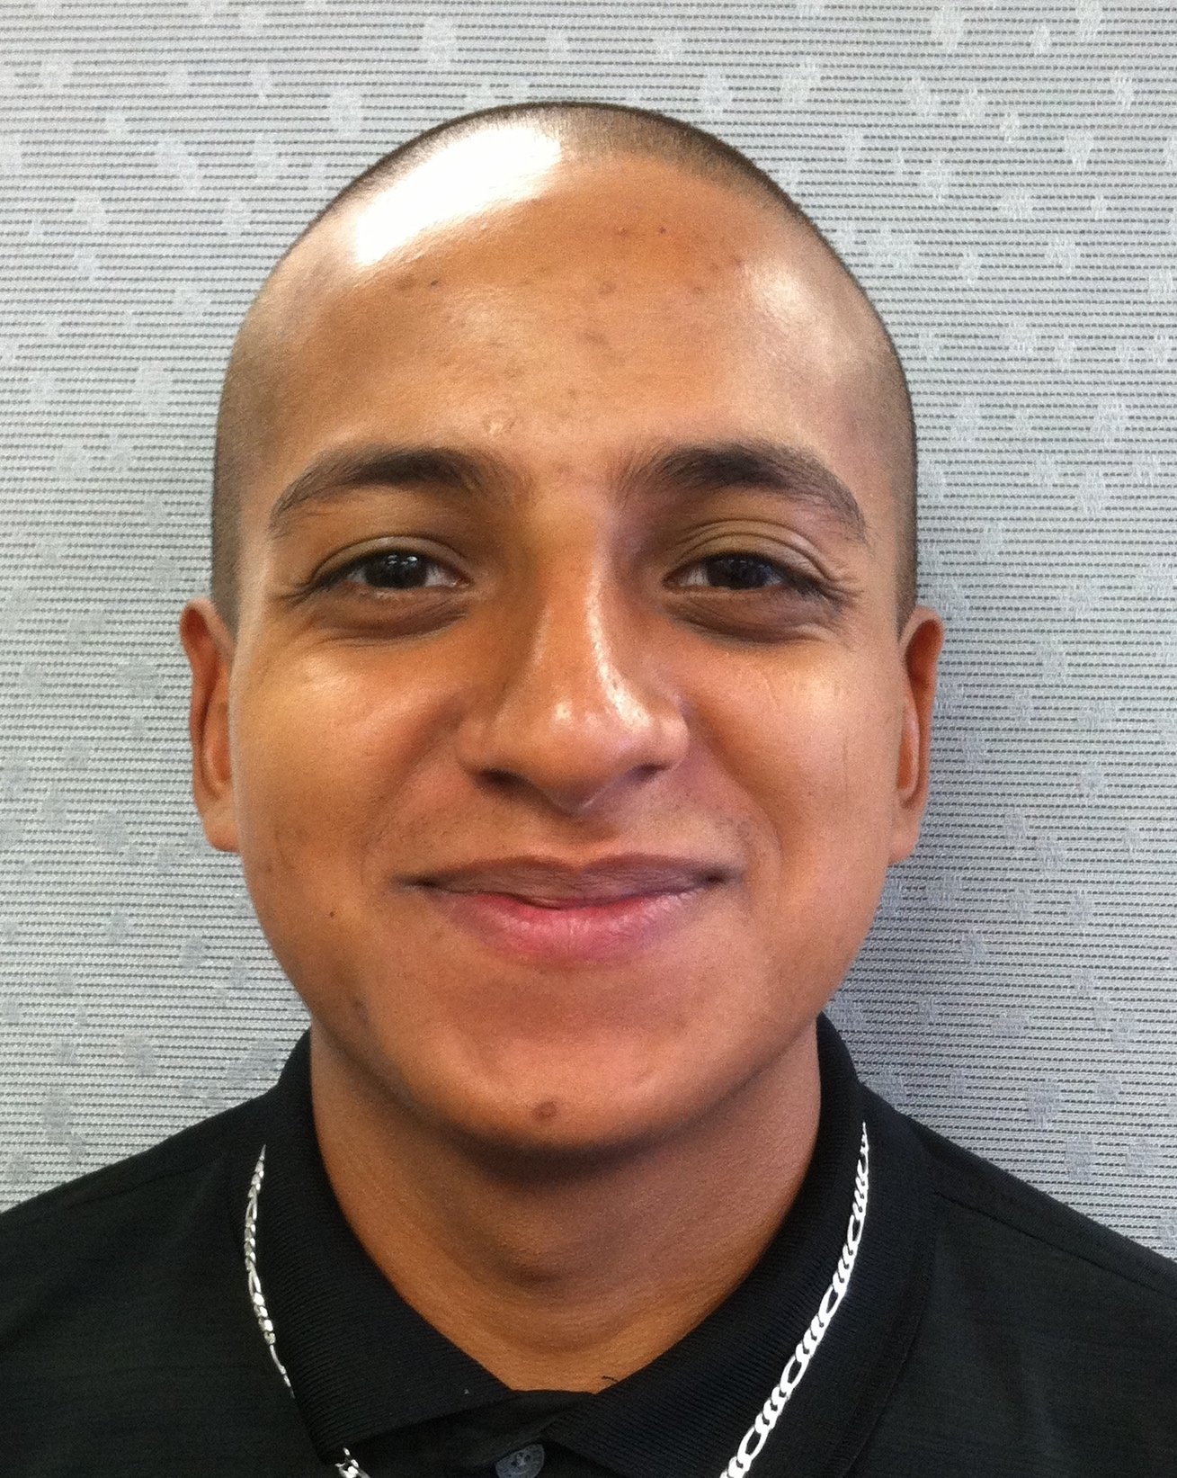
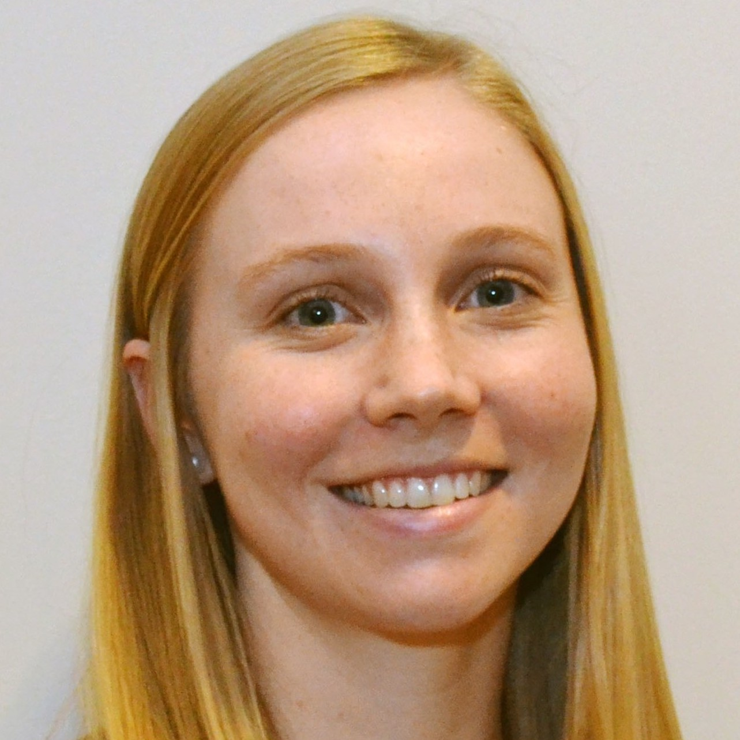
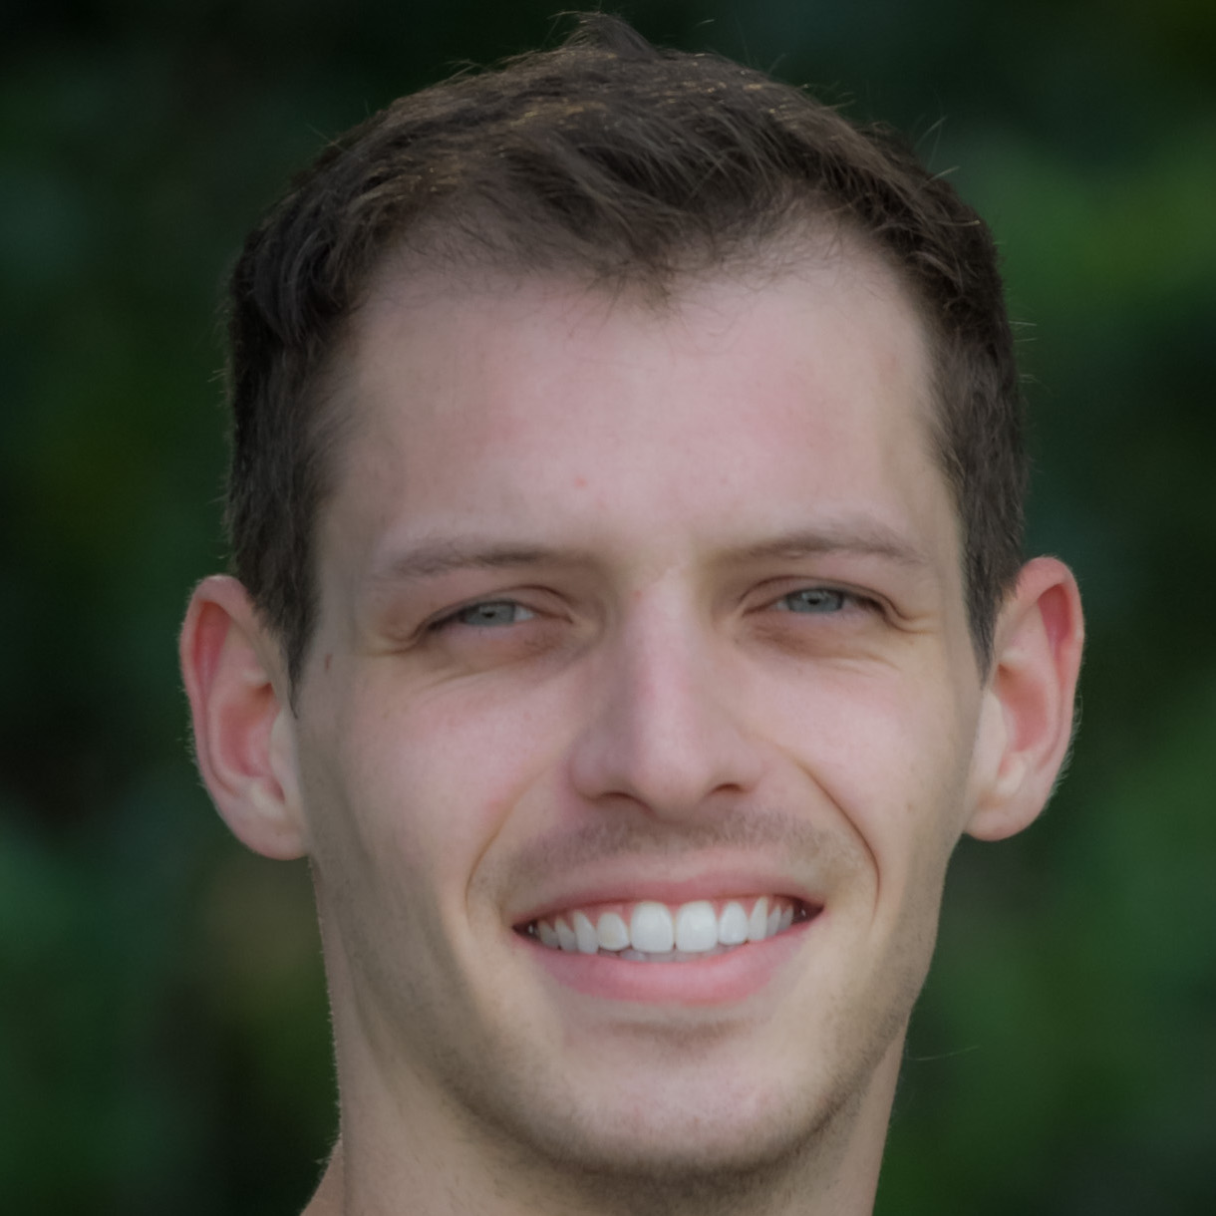
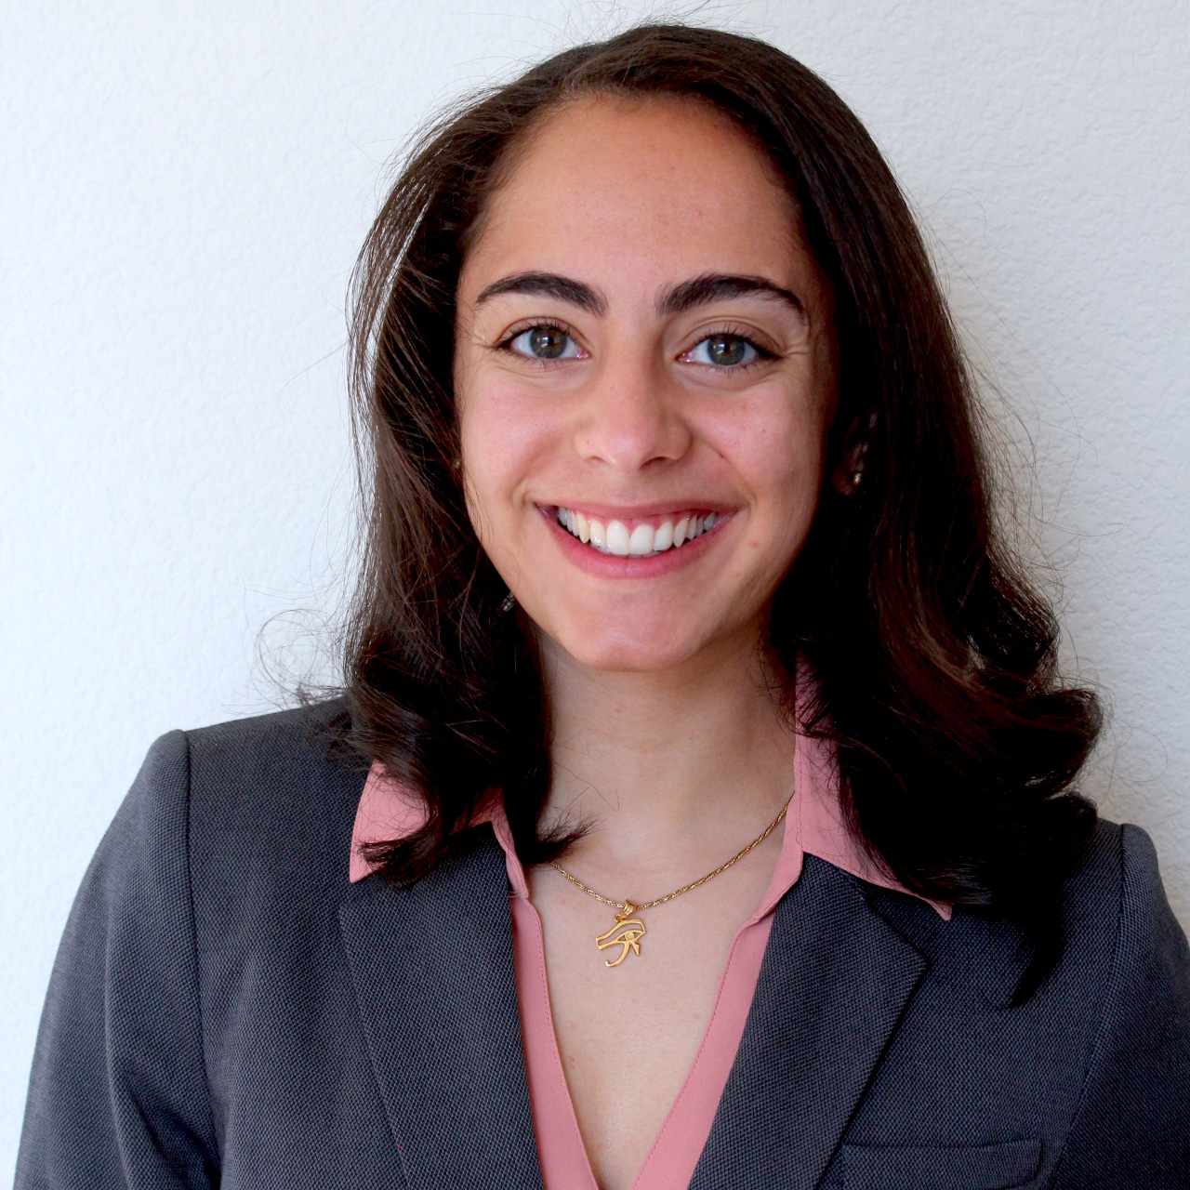
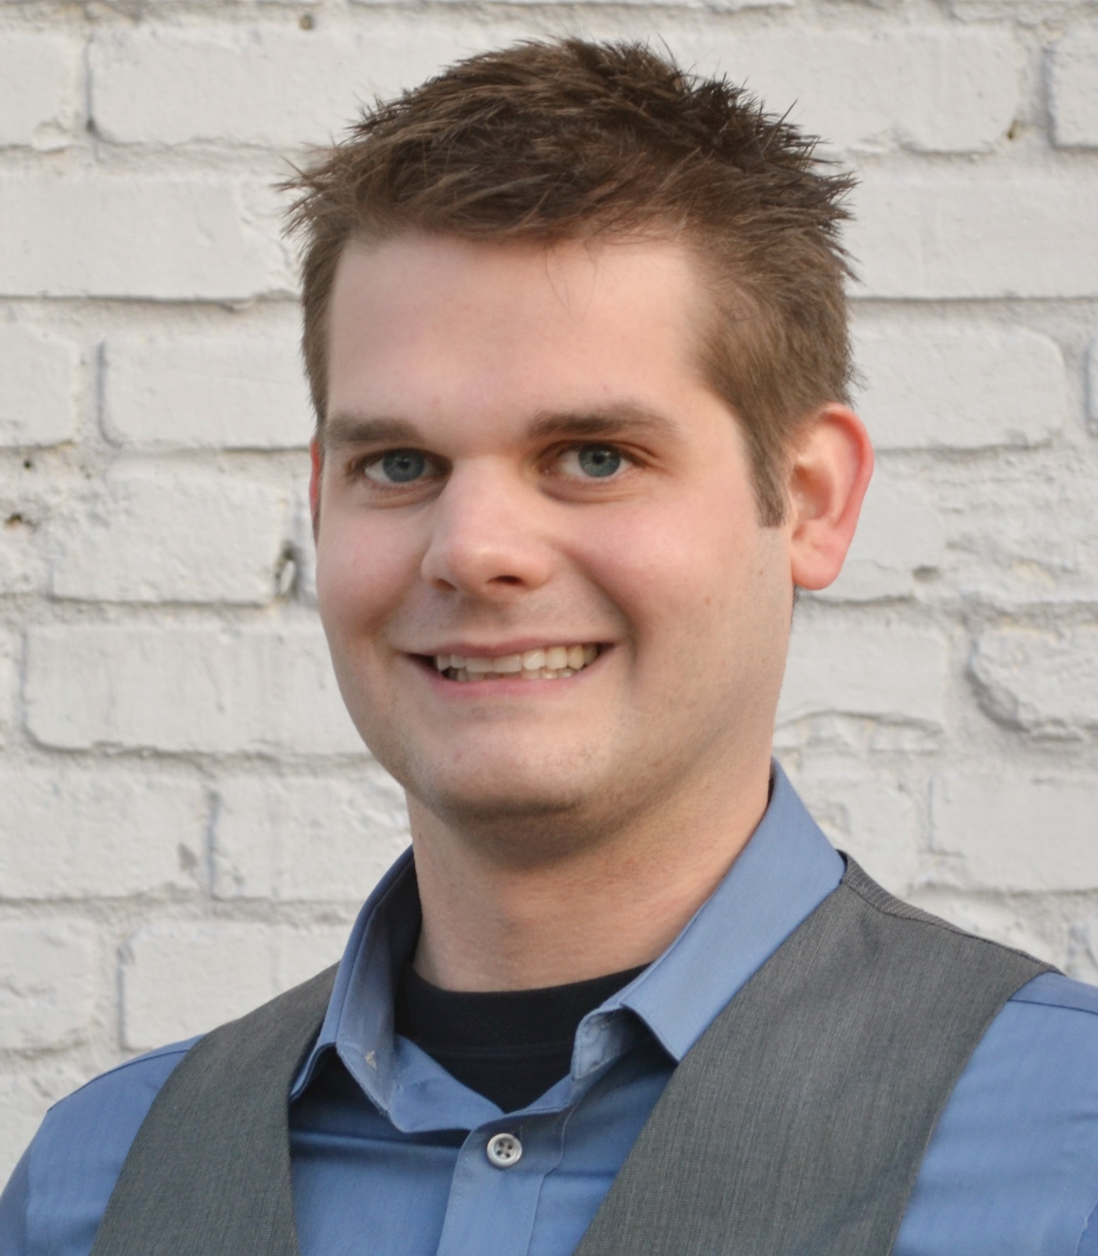
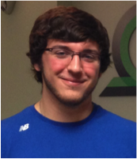
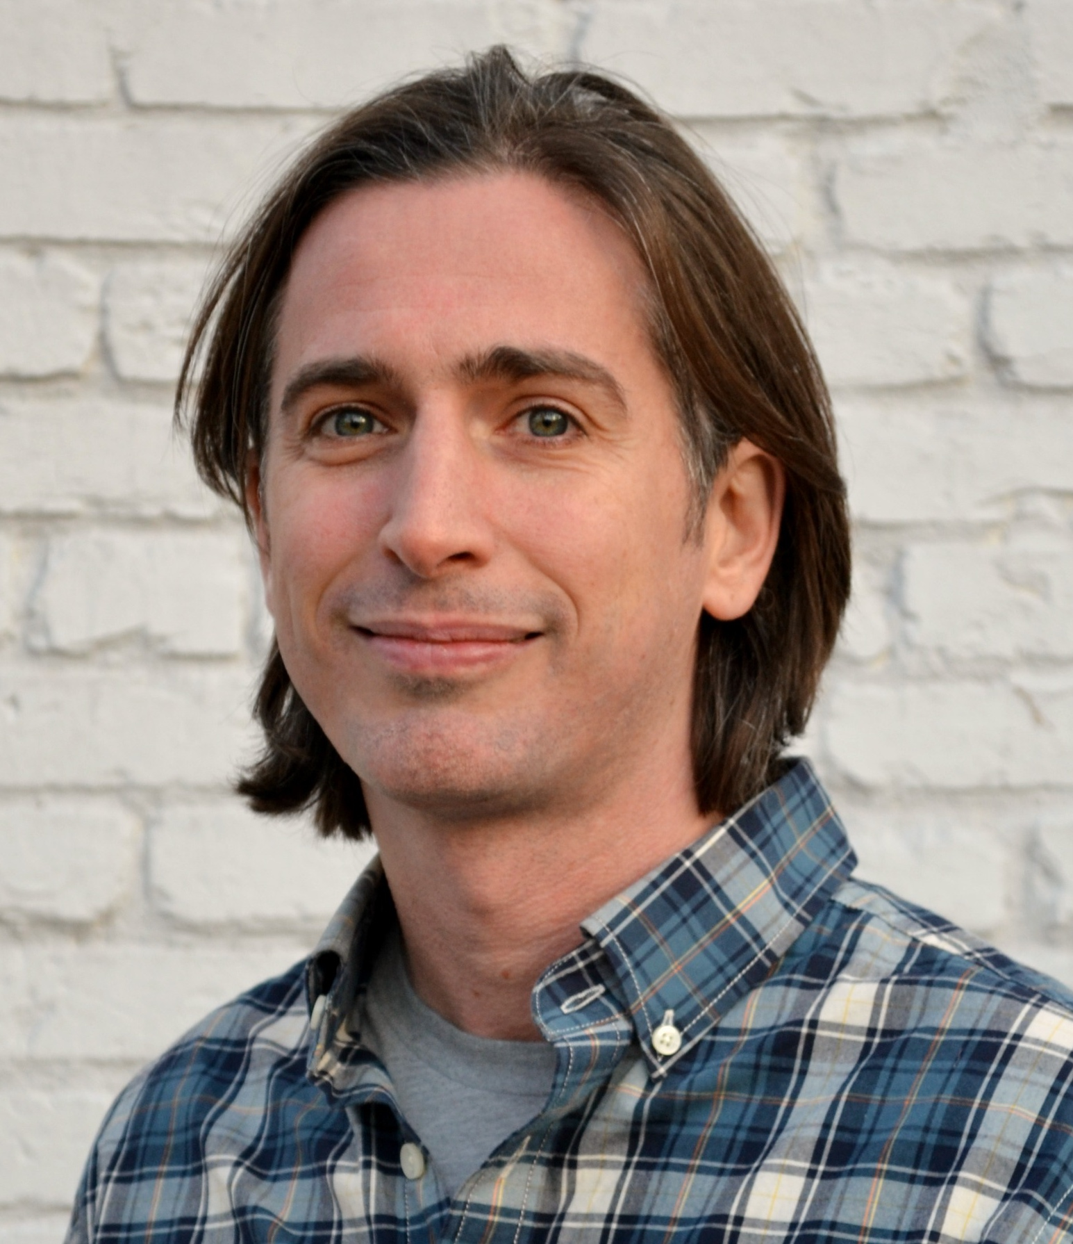
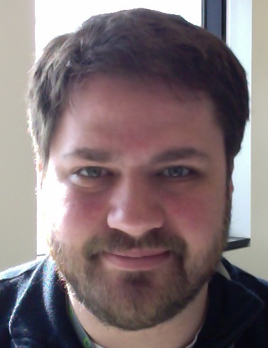


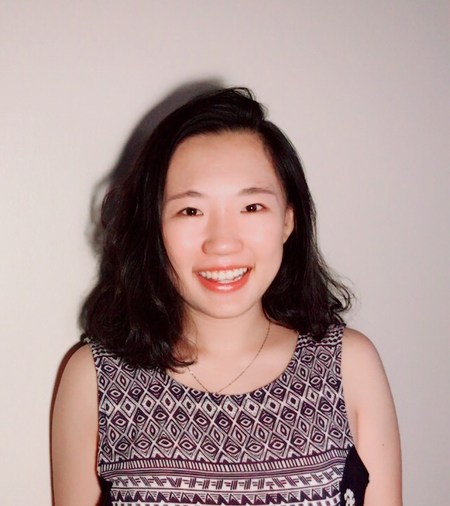
Acknowledgements (griffithlab.org/team/)
Malachi
Griffith
Obi
Griffith
Erica Barnell
Katie
Campbell
Kaitlin Clark
Adam
Coffman
Kelsy Cotto
Arpad Danos
Yang Yang Feng
Felicia Gomez
Jasreet
Hundal
Susanna Kiwalla
Kilannin
Krysiak
Lynzey
Kujan
Josh
McMichael
Shahil Pema
Cody
Ramirez
Megan Richters
Peter Ronning
Lana Sheta
Zachary
Skidmore
Nick
Spies
Lee
Trani
Alex
Wagner
Jason Walker
Alex Wollam
Huiming Xia

Slide 30
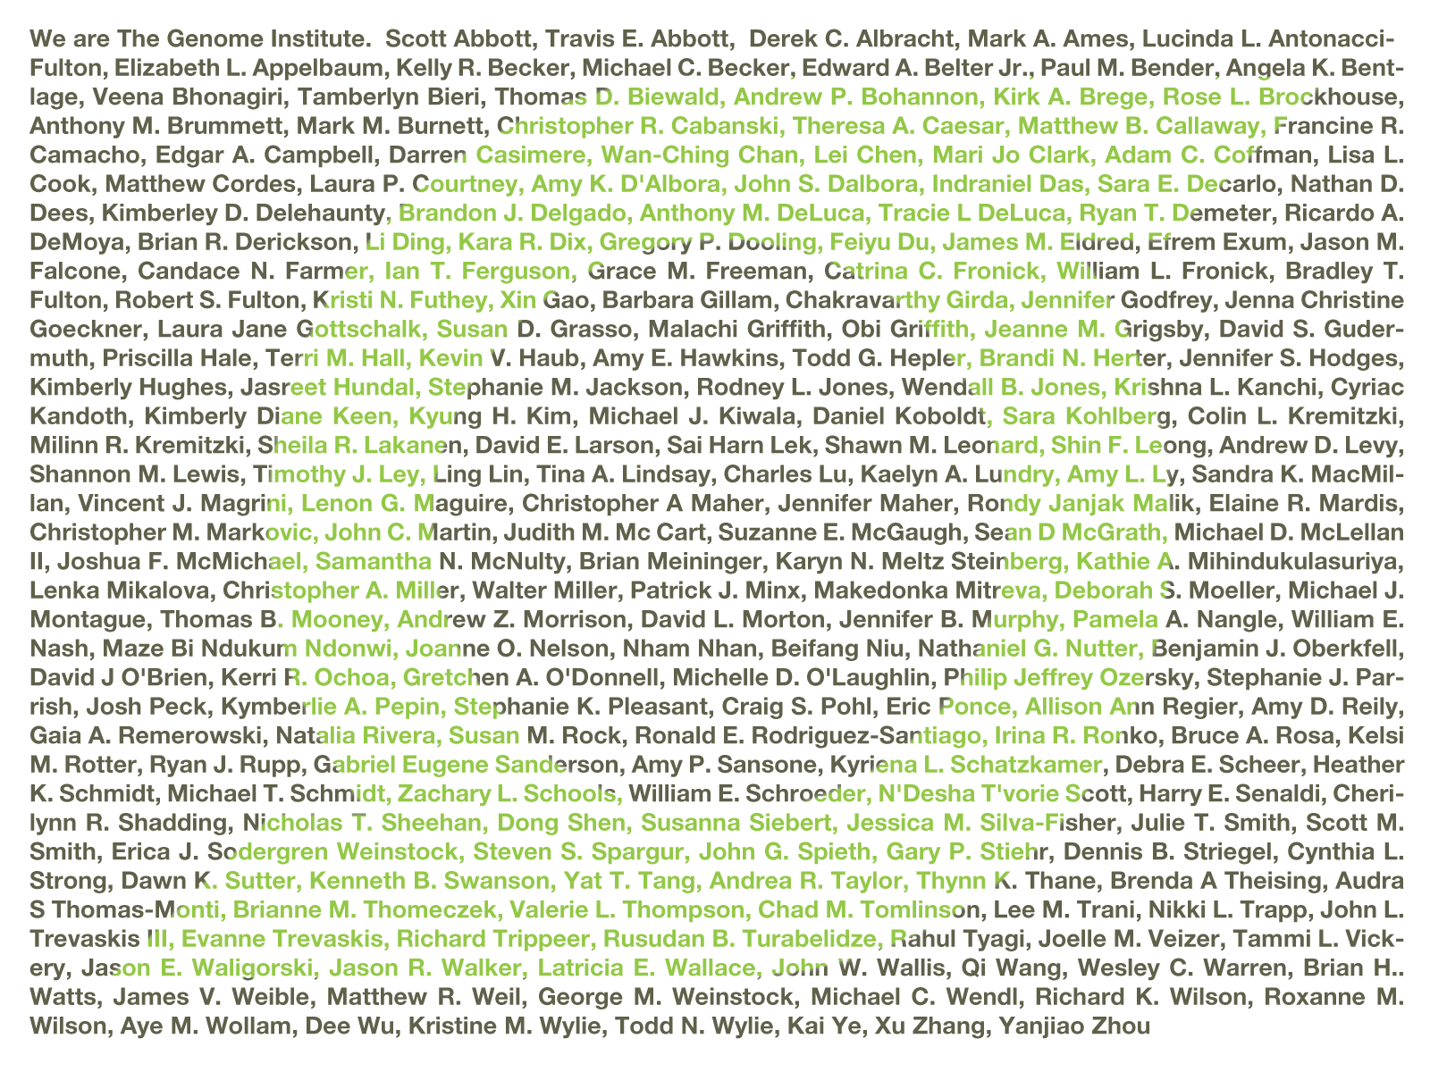
Acknowledgements: McDonnell Genome Institute
McDonnell Genome Institute @ Washington University School of Medicine

Slide 31
Genomic Data Visualization and Interpretation
Course goals - by the end of the course we hope you will:
Have a solid understanding of basic computational biology techniques for interpreting data
Be familiar with a variety of web resources (e.g., genome browsers and portals) to aid in the interpretation of omic data
Be able to use R graphical programs for data visualization (e.g., ggplot2, GenVisR) and interactive visualization (e.g., shiny)
Be able to perform, visualize, and interpret expression, differential expression and pathway analysis
Be able to assess a variant’s biological and clinical significance (e.g., VEP, ClinVar, and CIViC)
What this course does not cover:
Upstream genome analysis (alignment, variant calling, assembly, etc, etc)
Linux command line and other core bioinformatics skills
This is a relatively new workshop for us – feedback welcome!

Slide 32
Student introductions
Please introduce yourself: Name, affiliation and area of research
Student poll
Are you doing genomics research?
Do you consider yourself a bioinformatician?
What kind of NGS data are you working with?
WGS?
Exome?
RNAseq?
Epigenome?
Other?
What organism do you work with?
Did you bring data?

Slide 33
Student poll continued
Are you familiar with linux/command line?
Intermediate?
Expert?
Do you sometimes write code?
What language?
Are you familiar with R?
Intermediate?
Expert?
Are you familiar with ggplot?
Intermediate?
Expert?
Do you use git/github?

